Slide 1
Petrologia e Geodinamica
Laurea Magistrale in
Geologia di Esplorazione
Dipartimento di Scienze della Terra
Università degli Studi di Roma La Sapienza
Michele Lustrino
(michele.lustrino@uniroma1.it. Tel: 06 49914158. Stanza 114)

Slide 2
Part Two.
Mantle melting, melt extraction and
post-melting processes.
Mantle melting at spreading ridges.

Slide 3
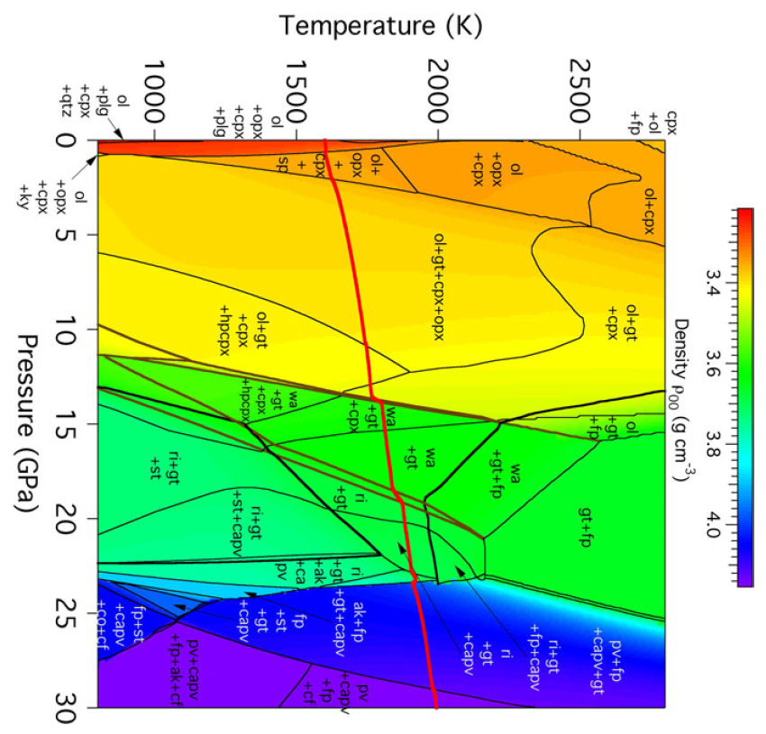
Phase diagram of a model pyrolite composition showing phase boundaries and the zero-pressure density of the assemblage.
Phase boundaries are shown as thin black lines except those among the olivine polymorphs (brown lines), and the reactions forming st and fp in the transition zone (bold black lines). Also plotted (bold red) is the 1600 K isentrope.
410 km
560 km
660 km
Stixrude and Lithgow-Bertelloni, 2011 (Geophys. J. Int., 184, 1180-1213)
Notes:
Il gradiente isentropico è uguale al gradient adiabatico (senza scambio di calore). A differenza del G. adiabatico, che può essere reversibile o irreversibile, il G. isentropico è sempre reversibile.

Slide 4
This diagram DOES NOT show the geotherm.
It illustrates the mineral assemblage of a pyrolitic mantle with a Potential Temperature (Tp) of 1600 K.
410 km
560 km
660 km
Stixrude and Lithgow-Bertelloni, 2011 (Geophys. J. Int., 184, 1180-1213)

Slide 5
What we think we know about mantle processes
The few things we know about the mechanisms acting in the upper mantle come from experimental petrology and observation of natural phenomena.
EXPERIMENTAL PETROLOGY
The materials used in experimental petrology studies are either natural upper mantle rocks (i.e., “real” peridotites, pyroxenites and eclogites, sometime “doped” with particular elements) or simplified laboratory systems (i.e., mixtures of synthetic oxides: CMAS, CMASF, CMASFN, CMASFNH, and so on).

Slide 6
What we think we know about mantle processes
The few things we know about the mechanisms acting in the upper mantle come from experimental petrology and observation of natural phenomena.
NATURAL PHENOMENA
The materials investigated are either partial melts (e.g., natural MORB glasses or natural igneous rocks) or upper mantle residua (e.g., mantle xenoliths, abyssal peridotites or tectonized ophiolites).
All of these show evidence for modifications towards refractory or refractory + refertilization.

Slide 7
What we think we know about mantle processes
The few things we know about the mechanisms acting in the upper mantle come from experimental petrology and observation of natural phenomena.
NATURAL PHENOMENA
Researchers have presented four basic
Model Mantle Compositions:
HZ (Hart & Zindler 1986),
HPY (Hawaiian Pyrolite - enriched),
MPY (MORB Pyrolite - fertile),
Tinaquillo lherzolite (depleted Pyrolite; Green and Falloon 1998).

Slide 8
What we think we know about mantle processes
The few things we know about the mechanisms acting in the upper mantle come from experimental petrology and observation of natural phenomena.
These model “parental” or “primitive” or “modern well mixed” mantle concur in Lherzolite characterized by [Ol > Opx > Cpx > (Plag/Sp/Gt)] with:
~45 wt% SiO₂,
~37-40 wt% MgO,
~8 wt% FeO_{tot},
~3-4 wt% Al₂O₃ and CaO,
<1 wt% Na₂O, K₂O, TiO₂ and P₂O₅
This range is considered a mean composition for the peridotitic upper mantle.

Slide 9
What we think we know about mantle processes
The few things we know about the mechanisms acting in the upper mantle come from experimental petrology and observation of natural phenomena.
A LOT OF PROBLEMS…
The main problem is that from these four different approaches the results obtained are very different.
In some cases the results are
COMPLETELY DIFFERENT

Slide 10
What we think we know about mantle processes
Experimental petrology says:
An undepleted lherzolitic mantle source is able to generate tholeiitic magmas at relatively shallow pressure and relatively high temperature.
The same source can generate sodic alkaline magmas if it melts at higher pressure and lower temperature regimes.
Do you remember the influence of P on the melting of enstatite?

Slide 11
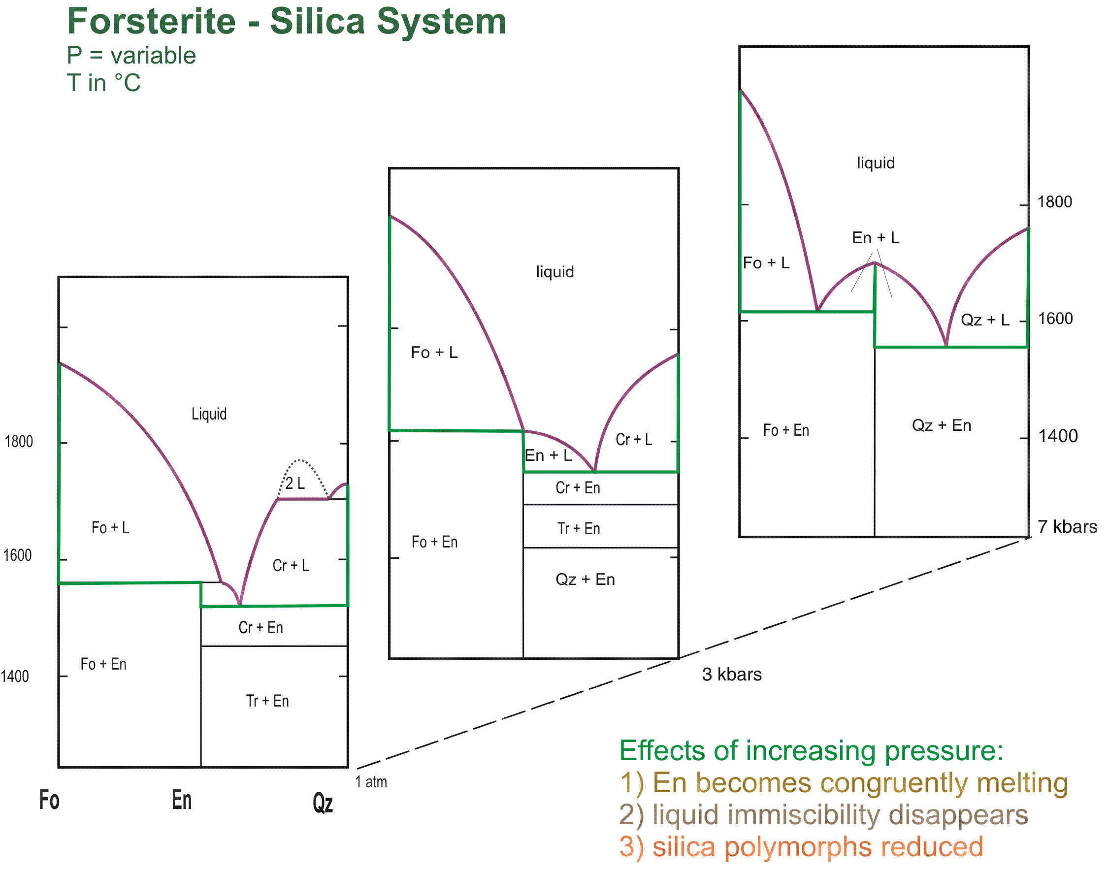
Forsterite-SiO₂ diagram
What is the first drop of melt?
What is the first drop of melt?
7 kb
What is the first drop of melt?
3 kb
A melt generated at high P will be richer or poorer in SiO₂ with respect to a low-P melt?
1 atm

Slide 12
What we think we know about mantle processes
Starting from a depleted mantle:
T (°C)
1100
1200
1300
1400
1500
1600
Quartz Tholeiite
% of normative olivine in the melt
Tholeiitic magmas can be generated after 10-30% partial melting degrees.
O%
5
Tholeiite
1O%
15%
10
% of produced melt
20%
Lowering P at near-constant T increases melt fraction and produces Ol-poorer and SiO₂-richer magmas.
P (kbar)
15
Olivine Tholeiite
20
Tholeiitic Picrite
30%
40%
15%
Solidus
10%
Opx out
25
20%
Cpx out
Jaques and Green, 1980 (Contrib. Mineral. Petrol., 73, 287-310).
30

Slide 13
What we think we know about mantle processes
Starting from a depleted mantle:
T (°C)
1100
1200
1300
1400
1500
1600
Quartz Tholeiite
% of normative olivine in the melt
Tholeiitic magmas can be generated after 10-30% partial melting degrees.
O%
5
Tholeiite
1O%
15%
10
% of produced melt
20%
Decreasing T at constant P reduces melt fraction and melts become Ol-richer and Alkali-rich
P (kbar)
15
Olivine Tholeiite
20
Tholeiitic Picrite
30%
40%
15%
Solidus
10%
Opx out
25
20%
Cpx out
Jaques and Green, 1980 (Contrib. Mineral. Petrol., 73, 287-310).
30

Slide 14
What we think we know about mantle processes
1.2 GPa
Forsterite
+ Liquid
Liquid
High Quartz + Liquid
Enstatite + High Quartz
1700
Forsterite
+ Enstatite
Enstatite + Liquid
T ºC
1600
1500
Mg₂SiO₄
MgSiO₃
SiO₂
Notes:
14

Slide 15
What we think we know about mantle processes
1.2 GPa
1.2 GPa
Liquid
Forsterite
+ Liquid
Liquid
Forsterite
+ Liquid
High Quartz + Liquid
High Quartz + Liquid
The incongruent melting of enstatite is responsible for the higher SiO₂ content of melts produced at shallow depths.
Enstatite + High Quartz
Enstatite + High Quartz
1700
1700
Forsterite
+ Enstatite
Forsterite
+ Enstatite
Enstatite + Liquid
Enstatite + Liquid
T ºC
T ºC
1600
1600
Forsterite
+ Liquid
Liquid
0.0001 GPa
Cristobalite + Liquid
Forsterite
+ Enstatite
Enstatite
+ Liquid
Enstatite + Cristobalite
1500
1500
SiO₂
Mg₂SiO₄
SiO₂
Mg₂SiO₄
MgSiO₃
MgSiO₃
Notes:
15

Slide 16
What we think we know about mantle processes
T (°C)
Starting from an undepleted mantle:
1100
1200
1300
1400
1500
1600
Quartz Tholeiite
% of normative olivine in the melt
5
O%
Qz-Normative tholeiites are restricted to Low P and melt ~15-45%.
With increasing P, melts at 15-30% become more olivine-rich to Tholeiitic Picrites at >15% melt but they are alkali-rich and nepheline-normative at <15% melt (20 kb)
15%
Tholeiite
10
Olivine Tholeiite
P (kbar)
20%
15
Alkali olivine basalt
25%
Tholeiitic Picrite
20
Alkali picrite
50%
30%
40%
25
Solidus
20%
Opx out
Cpx out
Jaques and Green, 1980 (Contrib. Mineral. Petrol., 73, 287-310).
30

Slide 17
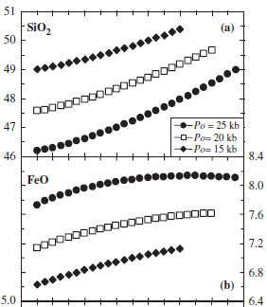
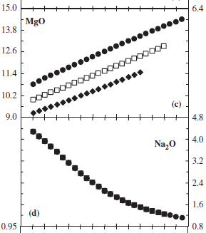
What we think we know about mantle processes
The paper of Jacques and Green (1980) for the first time provided evidence on how the bulk compositions of partial melts of mantle peridotite vary with melting conditions and mantle composition.
Niu and O’Hara, 2008 (J. Petrol., 49, 633-664)

Slide 18
What we think we know about mantle processes
It showed the relation between melt and residues, i.e. the control of melt composition by equilibrium between melt and residual phases, all of which are solid solutions of a number of components which partition between melt and residual phases.
Niu and O’Hara, 2008 (J. Petrol., 49, 633-664)

Slide 19
What we think we know about mantle processes
What happens with decreasing pressure of melting?
Why?
15 kb
Why?
20 kb
25 kb
20 kb
25 kb
15 kb
No relation with P
25 kb
Na₂O function only of the degree of melting
Why?
20 kb
15 kb
Why?
Niu and O’Hara, 2008 (J. Petrol., 49, 633-664)

Slide 20
What we think we know about mantle processes
…Actually the Cpx/Liq partition coefficient for Na changes particularly at P >20 kb so the near-solidus melts where residual cpx is significant in quantity decrease in Na/Ca with increasing P.
15 kb
Why?
20 kb
25 kb
20 kb
25 kb
15 kb
No relation with P
25 kb
Na₂O function only of the degree of melting
Why?
20 kb
15 kb
Why?
Niu and O’Hara, 2008 (J. Petrol., 49, 633-664)

Slide 21
What we think we know about mantle processes
Upper mantle partial melting is the sum of still poorly understood complex phenomena.
Before starting to argue about depths and temperatures of formation of complex magmas we will focus attention on the simplest natural system.
This is represented by Mid Ocean Ridge Basalts (MORB)
Why the simplest natural system?
The source can be assumed to be Ol+Opx+Cpx (>98%);
The melt composition is classically assumed to be nearly K- and volatile-free (not strictly true, but a necessary approximation to keep the system simple).

Slide 22
What we think we know about mantle processes
But are MORB really volatile-free melts?
MORB are classically attributed to decompression melting of upwelling upper mantle/asthenosphere at normal mantle temperature and melting has been considered to occur in the absence of significant volatiles (C-H-O).
Nevertheless, primitive MORB have water and carbon contents which are not negligible but rather are very low because of relatively high degrees of melting of a source with low carbon and hydrogen contents (see next lesson).
D.H. Green (http://www.mantleplumes.org/MantleTemp.html)

Slide 23
What we think we know about mantle processes
Uppermost mantle (down to 100-150 km) is essentially made up of peridotitic mineral assemblages (olivine + orthopyroxene + clinopyroxene + spinel/garnet).
This is the region where magmas form.
Why can magmas not derive from much deeper sources?
Magma is highly compressible (much more than solid mantle minerals).
This means that with increasing P the liquids can increase their density up to values higher than ambient solid mantle. This reduces their buoyancy and therefore becomes an obstacle for rising to the surface.

Slide 24
What we think we know about mantle processes
- The depth of melting is controlled by Earth’s geotherm and its intersection with the appropriate solidus.
- Whether magma segregates is further controlled by melt fraction (porosity) and permeability (melt viscosity, surface forces, melt distribution in pores, on faces, in intersects).
- <1-2% melt (incipient melt) is trapped or moves very slowly but permeability increases by ~2 orders of magnitude at> ~2% melt.

Slide 25
What we think we know about mantle processes
The density contrast between crystals (residuum) and liquids reduces at depths.
This means that it is very likely that crystal–liquid separation does not work effectively at great depths.
Buoyancy and permeability are the most important factors for controlling the transfer of magmas to the Earth’s surface and for inducing volcanic eruptions.
Importantly, and for low melt fractions particularly, vapour-phase separation and gas expansion with P decreasing also play a major part in buoyancy and in tension cracking (‘fracking’) e.g. dyke propagation and dyke swarms; joint-faces in Peridotite xenoliths; kimberlites.
Ohtani, 2009 (Chem. Geol., 265, 279-288)

Slide 26
What we think we know about mantle processes
Magma produced at great depths may be denser than the surrounding mantle because of their high compressibility, and these dense magmas may be stagnant deep in the mantle without uprising to shallower depths. This happens at P ~14 GPa.
Ohtani, 2009 (Chem. Geol., 265, 279-288)

Slide 27
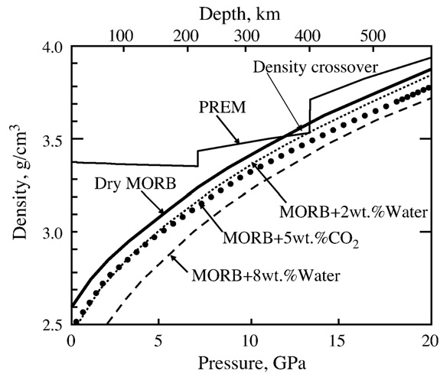
What we think we know about mantle processes
Magmas containing few % H₂O and CO₂ can be denser than the surrounding mantle.
A gravitationally stable volatile-rich magma can form at the base of the upper mantle.
Ohtani, 2009 (Chem. Geol., 265, 279-288)

Slide 28
What we think we know about mantle processes
If such a density crossover does exist
in the upper mantle, it has extremely important implications to magma genesis and the mode of chemical differentiation in the upper mantle.
It may be difficult for magmas generated below the depth of the density crossover to ascend to the surface of the Earth.
Ohtani, 2009 (Chem. Geol., 265, 279-288)

Slide 29
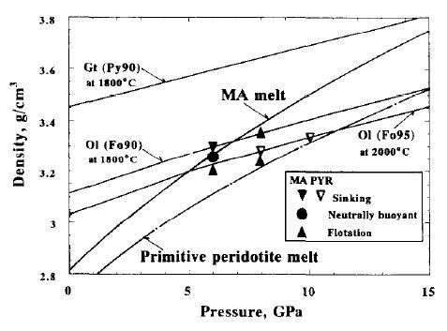
What we think we know about mantle processes
MA melt: Martian melt (Fe-richer , and therefore denser than Pyrolite melt)
3.8
Density crossover
3.6
3.4
Ol (Fo90)
Ol (Fo95)
3.2
3.0
2.8
0
5
10
15
Ohtani, 2009 (Chem. Geol., 265, 279-288)
Ohtani et al., 1995 (Chem. Geol., 120, 207-221)

Slide 30
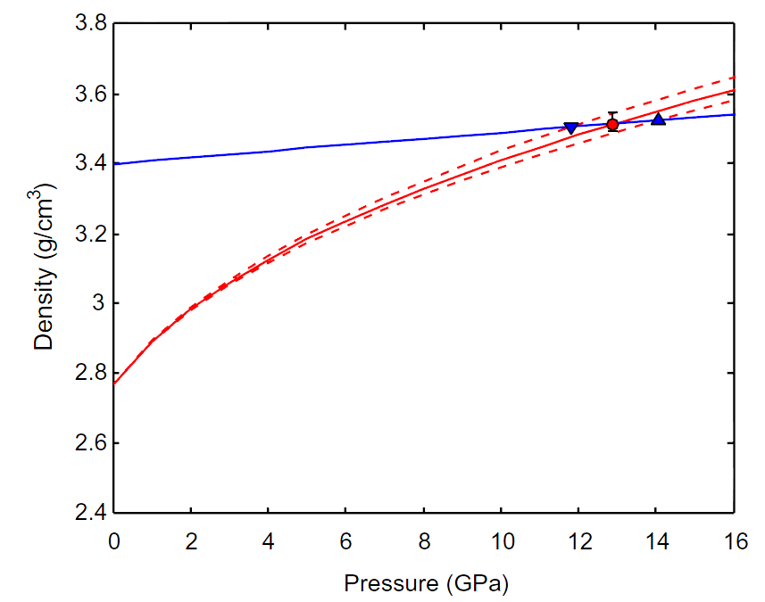
What we think we know about mantle processes
The presence of water can significantly reduce the density of melts due to its small molecular mass.
On the other hand, water makes hydrous silicate melts more compressible than anhydrous melts and therefore the effect of H₂O on melt density is less significant at high pressures.
Compression curves for diamond (blue triangles) and melt @2400 K.
Increase of density of the experimental melt
Jing and Karato, 2012 (Geochim. Cosmochim. Acta, 85, 357-372)
Notes:
30

Slide 31
What we think we know about mantle processes
Many of the experimental petrology data on upper mantle melting have been run at a pressure interval of 10-50 kb (1-5 GPa) on “fertile” to “refractory” peridotitic compositions (i.e., lherzolitic to harzburgitic) as starting material.
Most experiments are devoted to the petrogenesis of MORB and OIB.
Other projects have explored the conditions of formation of C-H rich melts (alkali olivine basalts to olivine melilitites and kimberlites).

Slide 32
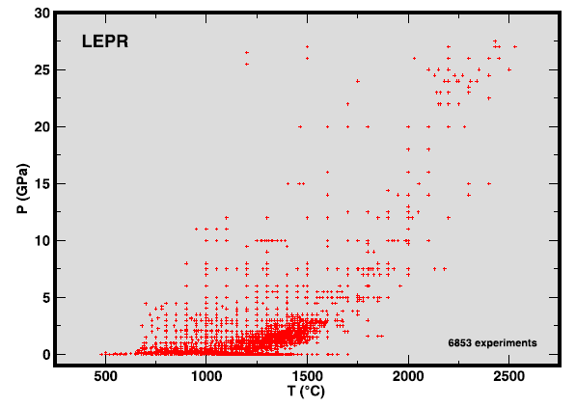
What we think we know about mantle processes
Database of more than 6,800 experimental studies:
(Library of Experimental Phase Relations)
5 GPa ~150 km
Hirschmann et al., 2008 (Geochem. Geophys. Geosyst., doi:10.1029/2007GC001894)

Slide 33
What we think we know about mantle processes
Most of our knowledge on MORB genesis (the simplest natural system of igneous rock formation) is based on isobaric experiments, whereas partial melting beneath oceanic ridges very likely is polybaric.
Many researchers believe that melts formed at depths in the mantle are extracted rapidly, without experiencing low-pressure re-equilibration during ascent. But this is improbable if melt moves via porous flow.

Slide 34
What we think we know about mantle processes
Most of our knowledge on MORB genesis (the volumetrically dominant natural system of igneous rock formation) is based on experiments determining melt and residue equilibrium at controlled P-T, and matching the experimental melt with natural magmas.

Slide 35
What we think we know about mantle processes
This approach assumes that melts formed at a particular depth and melt fraction in the mantle are extracted rapidly, without experiencing low-pressure re-equilibration during ascent.
The approach infers a ‘depth of magma segregation’ of melt from residue (equilibrated) and further transport through dunite channels or as dykes – without reaction and re-equilibration with wall-rocks at lower P,T (other than olivine precipitation).

Slide 36
What we think we know about mantle processes
An alternative view envisages a melting volume beneath MOR with varying near-solidus melts (P, T, Residue-controlled) moving by porous flow to a focus and separation at shallow depths beneath the MOR. However, porous flow would entail re-equilibration with lherzolite residue and adjustment of melt composition (Major and Compatible Trace Elements) to low P.
Mantle-derived parental or primitive MORB would be saturated with Ol, Opx, Cpx, Sp/Plag at low pressure.

Slide 37
What we think we know about mantle processes
Now we will see how poor our knowledge is on the mechanism of magma formation and its transfer to the surface making examples with the dominant mantle residue-melt pair:
The Abyssal Peridotite-MORB pair
Igneous crust [mid-ocean ridge basalts (MORB) plus dikes and lower-crustal gabbros] represents solidified partial melts whereas abyssal peridotites are melting residues.
Much of the text and figures of this section are from: Niu, 2004 (J. Petrol., 45, 2423-2458)

Slide 38
What we think we know about mantle processes
It is now widely accepted that plate separation at ocean ridges causes the mantle beneath to rise and to partially melt by decompression. Abyssal peridotites and igneous ocean crust are the two complementary products of such decompression melting.
The extent of mantle melting beneath normal oceanic ridges increases with spreading rate.
This supports the notion that ocean ridges are mostly passive upwellings of upper mantle.
This means that oceanic ridges are the places where the Earth cools. They are not anomalously hot areas.

Slide 39
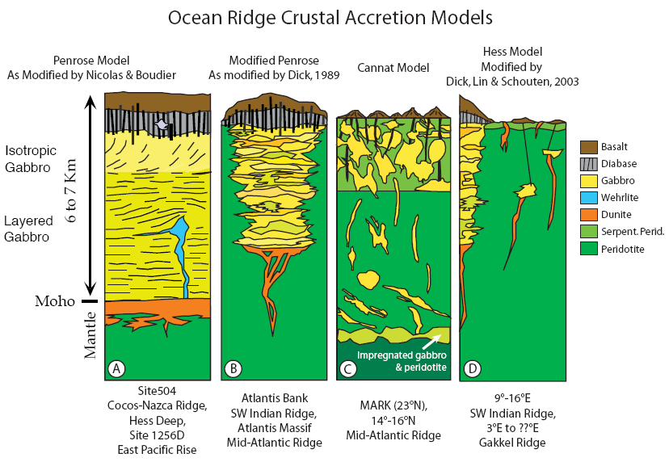
What we think we know about mantle processes
Different models of Oceanic Crust
(A) Classical Model (Ophiolite)
(B) Slow Spreading Model
(C) Abundant peridotite and minor gabbro Model
(D) Amagmatic Ridge Model in Ultraslow spreading Ridges
A
B
C
D
Basalt
Gabbro
Dunite
Peridotite
Diabase
(a type of basalt)
Wehrlite
(a type of peridotite)
Serpentine Peridotite
Notes:
39

Slide 40
What we think we know about mantle processes
The three fundamental variables that determine the extent of mantle melting, MORB composition and ocean crust production are:
Mantle potential temperature
Plate spreading rate
Mantle source composition
Nevertheless, details of mantle melting and physical mechanisms of melt extraction and delivery to the very narrow axial zone of crustal accretion remain somewhat elusive.

Slide 41
What we think we know about mantle processes
For example: Is ridge oblique and segmented?
Or orthogonal to spreading direction?
Is upwelling continuous and residual lithosphere entirely ‘new and young’ (as modellers like it)?
Or is upwelling discontinuous as diapirs from asthenosphere penetrating older lithosphere so that slow spreading = fewer diapirs, more relict old lithosphere?
If diapirs (best seen in slow spreading continent to ocean crust transition at early stage of separation) are the mechanism, then do they show wall-rock reaction or marginal cooling and crystallization (shrinking and ‘closed’)?

Slide 42
What we think we know about mantle processes
It is generally accepted that MORB are the complement of residual abyssal peridotites:
MORB + Residual Peridotite =
Original Mantle Source
(i.e., mantle composition before melting started).
Abyssal peridotites have been dredged and drilled in several localities during the last 50 years.
Together with mantle xenoliths in Na-alkaline lavas and ophiolitic massifs, the abyssal peridotites are the only direct probes of upper mantle composition and structure.

Slide 43
What we think we know about mantle processes
First CAVEAT:
Calculated melting parameters (degree and depth of melting) from MORB compositions are arguably invalid if the mantle source composition proves to be heterogeneous on all scales.
Remember the
SUMA Model.

Slide 44
What we think we know about mantle processes
First CAVEAT:
Melting of inhomogeneous mantle is a homogenising process:
Lowest solidus melt migrates into more refractory wall rock, reacts, freezes and enriches and so on with upwelling, until a continuum of melt through inhomogeneous residue enables melt extraction.
Ideally an originally inhomogeneous subducted slab may be reconstructed to a low permeability MELT+Ol+Opx+Cpx+Ga layered lherzolite in which layers represent original inhomogeneity (gabbro→Cpx-rich layer) bounded by Opx+Ga-rich layer.

Slide 45
What we think we know about mantle processes
First CAVEAT:
To use MORB composition as a proxy for igneous ocean crust in models of chemical geodynamics neglects the fact that MORB represent only a compositional end-member and constitute no more than 10–15% of the total crustal mass.

Slide 46
What we think we know about mantle processes
Abyssal peridotites should provide more direct information on mantle melting, melt extraction and post-melting processes.
A genuine understanding of the petrogenesis of abyssal peridotites remains out of reach because we do not have sufficient observations.
For example, everything we know about the abyssal peridotites from the literature is largely based on the same limited observations:
Mode of minerals
Major element compositions of residual minerals
Trace element data on residual cpx

Slide 47
Mantle melting, melt extraction and post-melting processes beneath mid-ocean ridges
Working Framework:
1. Plate separation at ocean ridges causes the asthenospheric mantle below to rise;
2. This upwelling (solid) mantle begins to melt when it intersects the solidus at a depth P₀;
3. Melting continues as the melting mantle rises (decompression) until it reaches a depth P_{f} as a result of conductive cooling to the seafloor;
4. The depth range between the base of the igneous crust and the depth of melting cessation (P_{f}) is termed ‘cold’ thermal boundary layer (TBL);

Slide 48
Mantle melting, melt extraction and post-melting processes beneath mid-ocean ridges
Working Framework:
Alternative or additional considerations:
1. The asthenosphere has incipient melt (<1-2%) and has low permeabilty;
2. Buoyancy and instability below LAB and viscosity decrease cause diapiric upwellings (compare salt domes or granite domes in deep crust);
3. Upwelling diapirs increasingly cooled at margins but internally approximates adiabatic upwelling and pass from incipient melt to major melting at P,T close to anhydrous solidus.

Slide 49
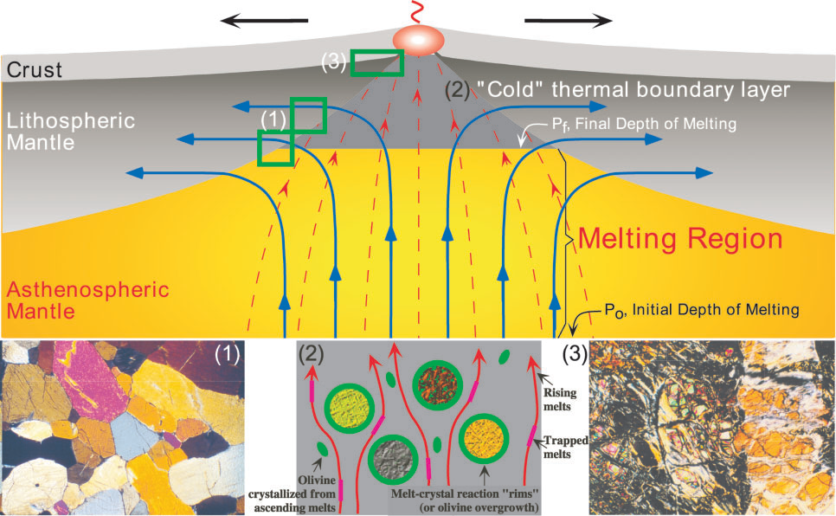
Mantle melting, melt extraction and post-melting processes beneath mid-ocean ridges
Niu, 2004, (J. Petrol., 45, 2423-2458)

Slide 50
Mantle melting, melt extraction and post-melting processes beneath mid-ocean ridges
5. No melting occurs in the TBL (pl-facies peridotite), but new ascending melts (red lines with arrows) migrate through and interact with the advanced residues of previous melting in the TBL;
Niu, 2004, (J. Petrol., 45, 2423-2458)
The thickness of the TBL increases with decreasing plate separation rate.
Experimental petrology says that MORB are generated at P ~1.5-2 GPa (i.e., in the sp-facies rather than pl-facies).

Slide 51
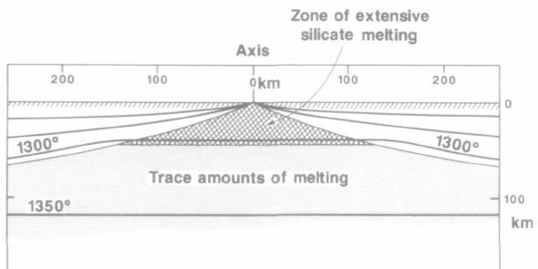
Mantle melting, melt extraction and post-melting processes beneath mid-ocean ridges
Two completely different models of melt generated by extension of lithosphere:
Zone of extensive silicate melting
Zone where silicate melts cool
(no melting is expected)
McKenzie and Bickle, 1988 (J. Petrol., 29, 625-679)
Niu ,2004 (J. Petrol., 45, 2423-2458)
The McKenzie and Bickle paper is considered a milestone of igneous petrology. The problem is that equilibration of melt and residue in the pl-facies has been excluded by all experimental petrology studies.

Slide 52
Mantle melting, melt extraction and post-melting processes beneath mid-ocean ridges
6. Residues from the central melting column rise to the shallowest level, experience significant melt refertilization or melt–solid interaction. They suffer also serpentinization.
Melts produced will ascend and migrate laterally towards the axial zone of crustal accretion.
Re-equilibration of major and trace elements as they migrate.
(3)
(2)
This explains why abyssal peridotites have excess olivine relative to simple melting residues.
These melts cool and crystallize olivine as they pass through previously depleted residues in the TBL.

Slide 53
Mantle melting, melt extraction and post-melting processes beneath mid-ocean ridges
7. On the other hand, melting residues away from the central column are likely to flow sideways at deep levels, leaving the sub-ridge magmatic system with limited melt refertilization or melt–solid interaction, and without being serpentinized;
No melting occurs in the TBL, but the advanced residues continue to rise and flow laterally away from the ridge (thick arrowed blue lines).
(3)
(2)
(1)

Slide 54
Mantle melting, melt extraction and post-melting processes beneath mid-ocean ridges
8. The latter residues could be preserved as fresh massif or ophiolitic peridotites in the geological record, but would never be the same as abyssal peridotites;
This requires that caution be exercised when comparing serpentinized abyssal peridotites with fresh ophiolitic/massif peridotites even if the latter can be proved to be MORB melting residues.
(3)
(2)
(1)
Niu, 2004 (J. Petrol., 45, 2423-2458)

Slide 55
How a simple mantle melts
In the melting region, decompression near-fractional melting is characterized by the reaction:
aCpx + bOpx + cSp = dOl + 1Melt
Clinopyroxene, orthopyroxene and spinel are consumed (enter the melt) whereas olivine crystallizes as melting proceeds.
At the moment there is no consensus on the values to give to the a-b-c-d melting mode amount.

Slide 56
How a simple mantle melts
In the melting region, decompression near-fractional melting is characterized by the reaction:
aCpx + bOpx + cSp = dOl + 1Melt
Clinopyroxene, orthopyroxene and spinel are consumed (enter the melt) whereas olivine crystallizes as melting proceeds.
According to the modal abundance of mantle residua (abyssal peridotites) it seems that Opx contributes more than Cpx to the melt (i.e., b>a) during decompression melting.
This is in contrast with isobaric melting experiments, but is constrained by the incongruent melting of Opx = Ol + SiO₂-rich melt with decreasing pressure.

Slide 57
How a simple mantle melts
In the melting region, decompression near-fractional melting is characterized by the reaction:
aCpx + bOpx + cSp = dOl + 1Melt
This is the classical way of expressing melting BUT remember that ALL minerals are solid solutions and do not contribute to the melt as their subsolidus compositions.
E.g. Na,Ca (in Cpx); Cr,Al (in Sp,Cpx,opx); Al,Ti (in Cpx,Sp); Al,Si (in Cpx,Opx).
Strictly speaking, a,b,c,d have no meaning.
In other words:
Melting reactions are not simple expressions of subsolidus compositions.

Slide 58
How a simple mantle melts
Residual (i.e., in abyssal peridotites) ol, opx and cpx modes of polybaric near-fractional melting model residues plotted against the extent of melting (F).
Opx and Cpx are consumed, while Ol is produced during mantle partial melting.
Each line is a decompression path with increasing F, beginning at appropriate solidus depths:
(Po = 30, 20, 10 kbar) and ending at ~3 kbar.
Ol
Opx
Residual Modes
(weight fraction
Cpx
Niu, 1997 (J. Petrol., 38, 1047-1074)

Slide 59
How a simple mantle melts
MELTING MODES. Clearly ol is being created, whereas opx and cpx melt during decompression melting. In the pressure range appropriate for MORB genesis opx melts more (is more negative) than cpx.
Cpx melting mode is independent of P.
On the other hand, Opx and Ol melting modes are nearly complementary.
Melting Modes
(weight fraction
Opx contributes more than Cpx to the melt.
Niu, 1997 (J. Petrol., 38, 1047-1074)

Slide 60
How a simple mantle melts
MELTING MODES. Clearly ol is being created, whereas opx and cpx melt during decompression melting. In the pressure range appropriate for MORB genesis opx melts more (is more negative) than cpx.
Moreover:
The more opx melts, the more olivine is produced.
Melting Modes
(weight fraction
Niu, 1997 (J. Petrol., 38, 1047-1074)

Slide 61
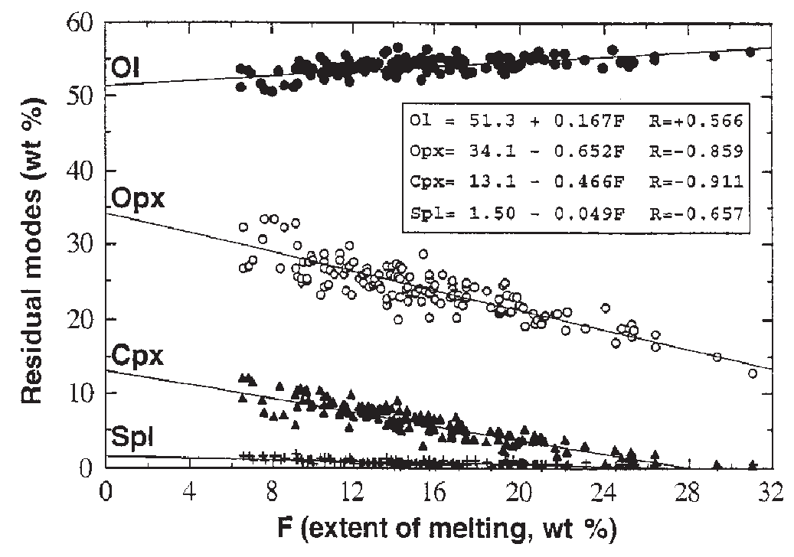
How a simple mantle melts
The values of a, b, c and d have been calculated as:
0.466Cpx + 0.652Opx + 0.049Sp = 0.167Ol + 1.000Melt
These come from the following relation:
Weight percent of residual mineral phases (calculated to a total mass of 100 – F%) in abyssal peridotites plotted against the extent of melting (F, wt %)
Niu, 1999 (J. Petrol., 40, 1195-1203)

Slide 62
How a simple mantle melts
The values of a, b, c and d have been calculated as:
0.466Cpx + 0.652Opx + 0.049Sp = 0.167Ol + 1.000Melt
What does this equation say?
In order to produce 1.000 mass unit of a basaltic melt, 0.466 mass unit of cpx, 0.652 mass unit of opx, and 0.049 mass unit of spinel are required to melt whereas about 0.167 mass unit of olivine is required to crystallize, suggesting that mantle melting is indeed incongruent.

Slide 63
How a simple mantle melts
The values of a, b, c and d have been calculated as:
0.466Cpx + 0.652Opx + 0.049Sp = 0.167Ol + 1.000Melt
In other words:
~117 grams
46.6 g Cpx + 65.2 g Opx + 4.9 g Sp = 16.7 g Ol + 100 g Melt
~117 grams

Slide 64
How a simple mantle melts
The values of a, b, c and d have been calculated as:
0.466Cpx + 0.652Opx + 0.049Sp = 0.167Ol + 1.000Melt
What does this equation say?
The incongruent melting of opx is the key parameter also because partial melting beneath oceanic ridges may happen not as consequence of thermal anomalies but rather as consequence of upwelling and decompression in response to plate separation.

Slide 65
How a simple mantle melts
As evidenced before, it remains a debated argument if orthopyroxene melts more than clinopyroxene during upper mantle decompression melting.
This is just to understand how far from full comprehension of mantle dynamics we are.
Indeed, I have previously shown you some results favouring opx/cpx ratios >1 entering the melt phase (e.g., Niu’s work), but this conclusion is not accepted by the entire scientific community.

Slide 66
How a simple mantle melts
There are natural observations suggesting that also clinopyroxene (diopside) may melt incongruently.
This means that what I have shown you up to now may be not completely correct.
However this is not the place to describe these arguments in greater detail.

Slide 67
How a simple mantle melts
According to other authors larger amounts of cpx melt than opx.
As an example M. Walter proposed in 1999 the following melting reations occurring at different P:
cpx + spinel = melt + olivine + opx (1.8-2.5 GPa)
opx + cpx + spinel = melt + olivine (1.1-1.7 GPa)
olivine + opx + plagioclase = melt + cpx + spinel (1 GPa)
cpx + opx + plagioclase = melt + olivine (0.6-0.9 GPa).

Slide 68
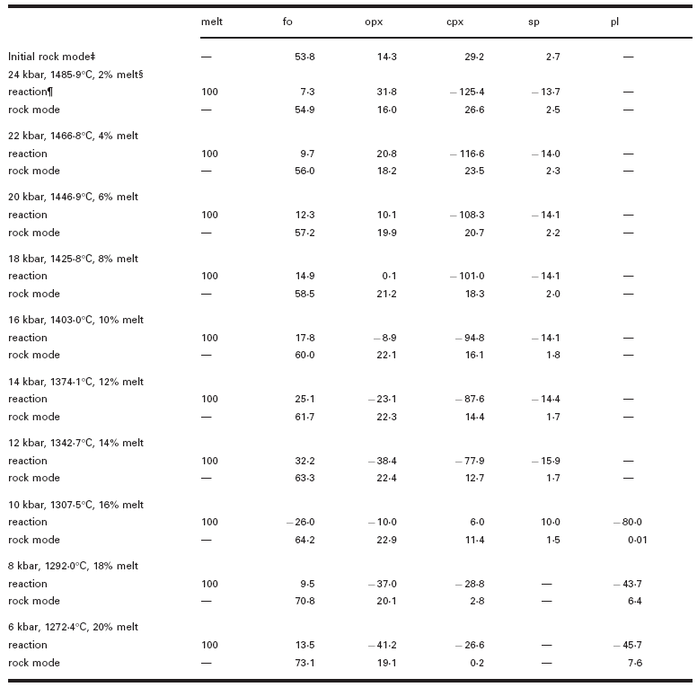
How a simple mantle melts
+139.1 gr
-139.1 gr

Slide 69
How a simple mantle melts
Walter, 1999 (J. Petrol., 40, 1187-1193)

Slide 70
How a simple mantle melts
Here are two other melting reactions obtained from a spinel fertile lherzolite @ 1 GPa:
0.380 Opx + 0.710 Cpx + 0.130 Sp =
1.000 Liq + 0.220 Ol
1
2
0.090 Opx + 0.907 Cpx + 0.039 Sp =
1.002 Liq + 0.034 Ol
These two equations differ substantially in several aspects but they have a common feature: Cpx enters the melt more than Opx.
1 = Baker and Stolper, 1994 (Geochim. Cosmochim. Acta., 58, 2811-2827)
2 = Falloon et al., 2008 (J. Petrol., 49, 591-613)

Slide 71
How a simple mantle melts
The melting reactions @ 1.5 GPa obtained from the spinel fertile lherzolite are:
0.360 Opx + 0.806 Cpx + 0.037 Sp =
0.987 Liq + 0.216 Ol
i.e., also at higher pressures
Cpx enters the melt more than Opx.
Falloon et al., 2008 (J. Petrol., 49, 591-613)

Slide 72
How a simple mantle melts
1.1 GPa:
0.30 Opx + 0.81 Cpx + 0.13 Sp + 0.04 Vapor = 0.30 Fo + 1.00 Liq
1.4 GPa:
0.29 Opx + 0.86 Cpx + 0.12 Sp + 0.05 Vapor = 0.30 Fo + 1.00 Liq
1.7 GPa:
0.22 Opx + 0.93 Cpx + 0.11 Sp + 0.05 Vapor = 0.31 Fo + 1.00 Liq
1.9 GPa:
0.15 Opx + 0.91 Cpx + 0.13 Sp + 0.04 Vapor = 0.24 Fo + 1.00 Liq
Keshav and Gudfinnsonn, 2013 (J. Geophys. Res., 118, 1–13, doi:10.1002/jgrb.50249)

Slide 73
How a simple mantle melts
Polybaric, near-fractional melting of lherzolite
What does this diagram show?
Residual mineral modes vs. degree of melt depletion from 25 to 6 kbar using phase equilibrium data from the CMASN system.
?
Walter, 1999 (J. Petrol., 40, 1187-1193)

Slide 74
How a simple mantle melts
Polybaric, near-fractional melting of lherzolite
One percent melt is extracted at each pressure, and the bulk composition is sequentially depleted. Mineral modes are calculated by mass balance from the phase compositions that occur at the conditions of melting.
Walter, 1999 (J. Petrol., 40, 1187-1193)

Slide 75

How a simple mantle melts
Polybaric, near-fractional melting of lherzolite
However, as noted by Niu in 1999, this positive correlation between olivine and orthopyroxene is very strange.
Walter, 1999 (J. Petrol., 40, 1187-1193)

Slide 76
How a simple mantle melts
Polybaric, near-fractional melting of lherzolite
Indeed, in natural examples (abyssal peridotites but also peridotitic massifs), orthopyroxene mode is negatively correlated with olivine mode.
Niu, 1999 (J. Petrol., 40, 1195-1203)

Slide 77
How a simple mantle melts
Polybaric, near-fractional melting of lherzolite
Niu’s approach is based on the observation of natural mantle residua.
Walter’s approach is based on isobaric laboratory’s experiments.
The main discrepancy is linked to the role of enstatite.
Walter, 1999 (J. Petrol., 40, 1187-1193)

Slide 78
How a simple mantle melts
Polybaric, near-fractional melting of lherzolite
According to Niu opx is consumed during melting.
According to Walter opx is not consumed (increases relatively because cpx decreases) during melting (at least at P >17 kbar).
Walter, 1999 (J. Petrol., 40, 1187-1193)

Slide 79
How a simple mantle melts
Polybaric, near-fractional melting of lherzolite
Another difference:
According to Niu opx is consumed more than cpx.
According to Walter opx is consumed less than cpx (at P 17-10 kbar).
Walter, 1999 (J. Petrol., 40, 1187-1193)

Slide 80
How a simple mantle melts
To resume:
1. According to some researchers (e.g., Niu) Opx is consumed more than Cpx during adiabatic decompression melting.
2. According to other researchers (e.g., Walter) Opx is not consumed during adiabatic decompression melting.
3. According to others (e.g., Falloon, Green) both Opx and Cpx are consumed during adiabatic decompression melting, with Cpx entering the melt more than Opx.

Slide 81
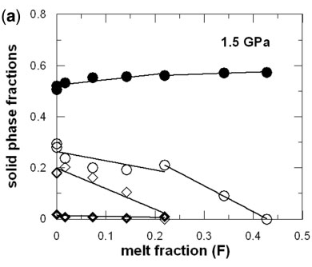
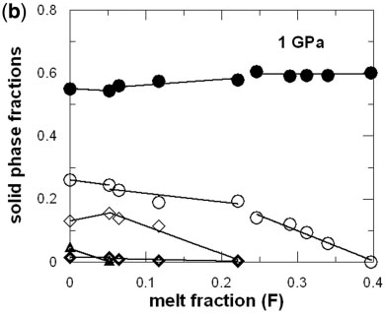
How a simple mantle melts
The residual mineral mode as function of melt depletion according to Falloon et al (2008)
Olivine
Orthopyroxene
Clinopyroxene
Spinel
Plagioclase
In this case both Opx and Cpx are consumed, but Cpx is consumed more than Opx.

Slide 82
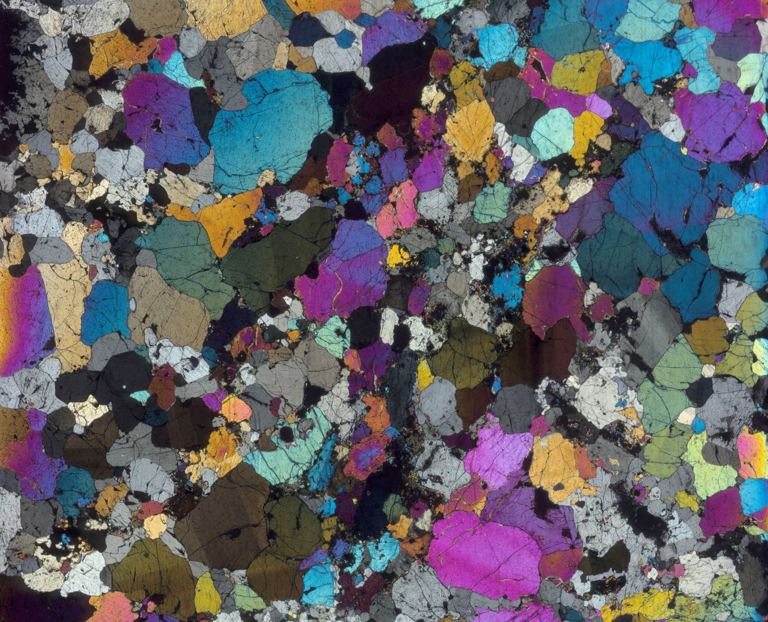
How a simple mantle melts
Polybaric, near-fractional melting of lherzolite
Some natural examples from Italy
This is a lherzolitic mantle xenolith from Sardinia seen with crossed polars.
What do you see?
Large deformed olivine, slightly smaller opx and minor amounts of cpx and spinel.
1 cm

Slide 83
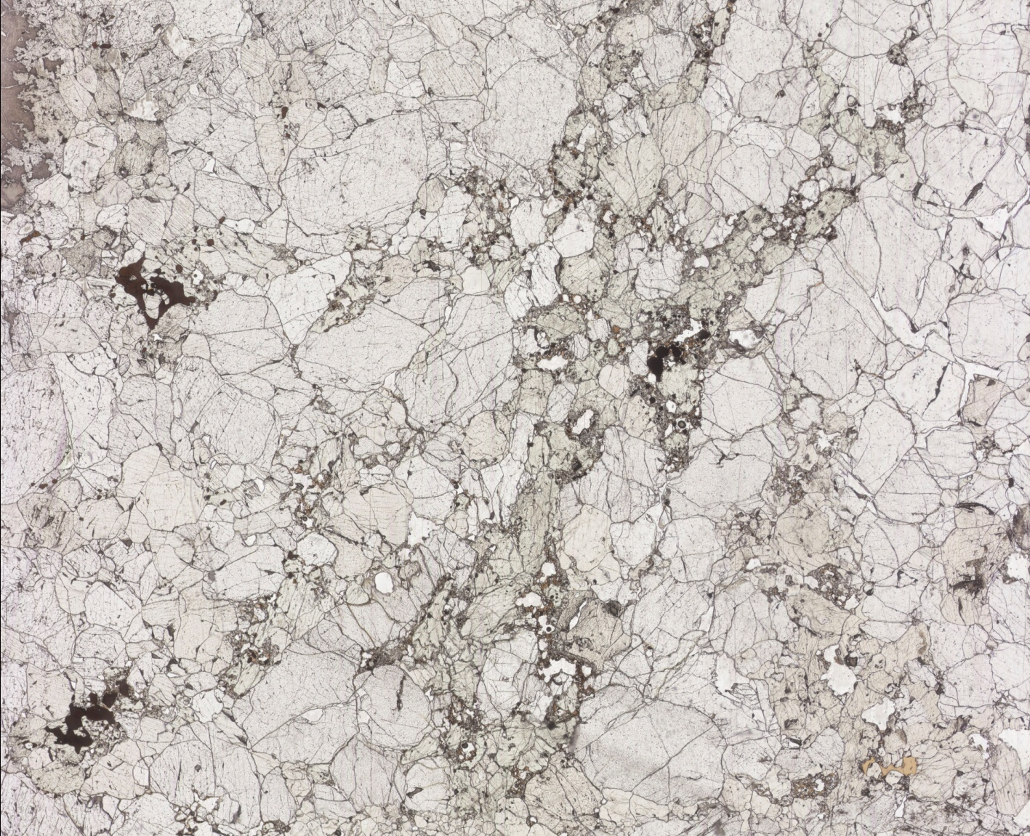
How a simple mantle melts
Polybaric, near-fractional melting of lherzolite
Some natural examples from Italy
This is a lherzolitic mantle xenolith from Sardinia seen in plane polarized light.
What do you see?
Not much clear.
Let’s zoom in.
1 cm

Slide 84
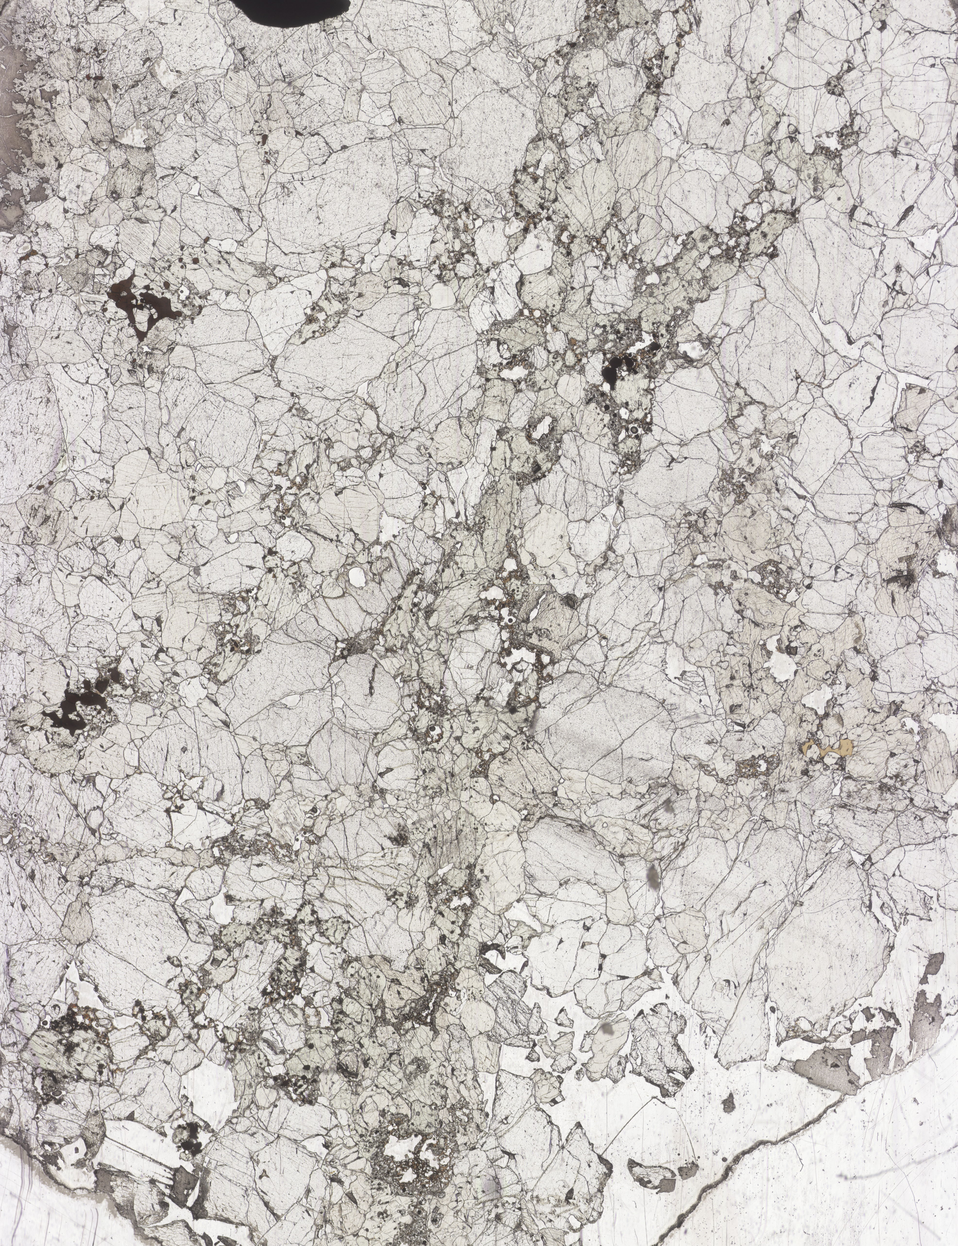
How a simple mantle melts
Polybaric, near-fractional melting of lherzolite
Some natural examples from Italy
A close-up highlights some interesting features.
There is a cluster of cpx with spongy borders.
These spongy zones are associated with black spinel and brown glass.
Ol
Cpx
Opx
Ol
Cpx
Ol
Cpx
Ol
Ol
Cpx
Cpx
Ol
Ol
Ol
Cpx
Ol
Cpx
Cpx
Opx
Cpx
Ol
Zoom in again.
Ol
0.1 cm

Slide 85
How a simple mantle melts
Polybaric, near-fractional melting of lherzolite
Some natural examples from Italy
Here a fundamental process appears clear:
Cpx is melting. It melts when in contact with spinel. Where in contact with olivine or opx its borders are unaffected by partial melting.
Brown glass appears in the spongy zones, together with cpx and sp relicts.
Ol
Cpx
Cpx
Cpx
Gl
Cpx
Cpx
Cpx
Sp
Gl
Gl
Sp
Sp
Gl
Gl
Ol
Sp
Ol
Cpx
50 μm

Slide 86
How a simple mantle melts
Polybaric, near-fractional melting of lherzolite
Some natural examples from Italy
Here a fundamental process appears clear:
Cpx is melting. It melts when in contact with spinel. Where in contact with olivine or opx its borders are unaffected by partial melting.
Brown glass appears in the spongy zones, together with cpx and sp relicts.
Remember one of the equations proposed by Walter?
cpx + spinel = melt + olivine + opx (1.8-2.5 GPa)
It seems that in these mantle xenoliths it is happening something of similar.

Slide 87
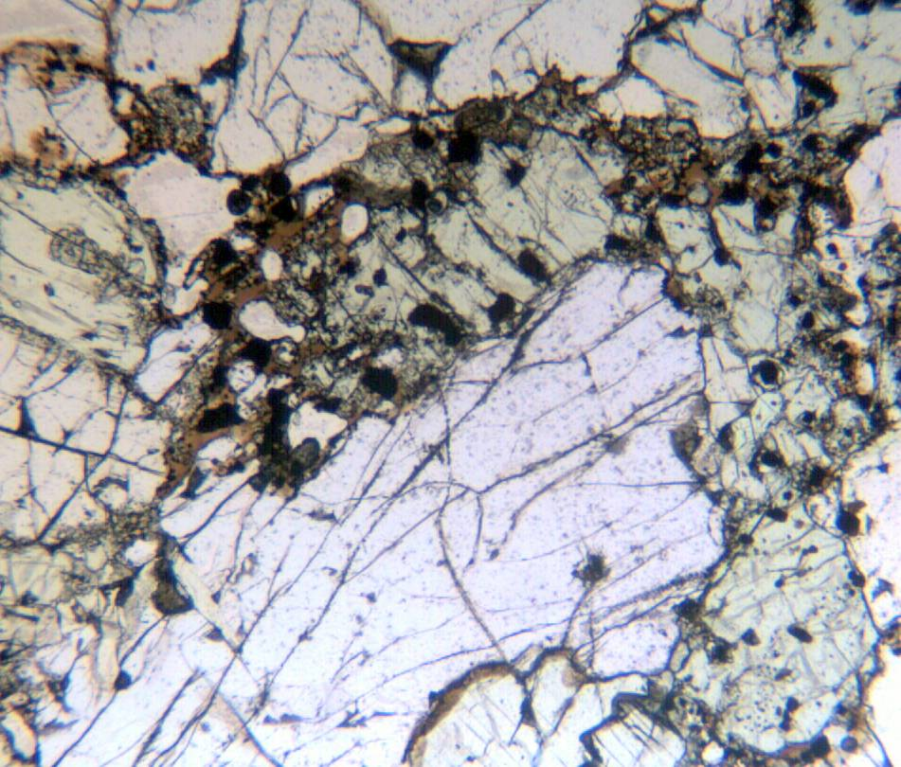
How a simple mantle melts
Polybaric, near-fractional melting of lherzolite
Some natural examples from Italy
Ol
This is another lherzolitic mantle xenolith from Sardinia.
Ol
Cpx
Cpx
Again, olivine and opx do not show any particular features.
Cpx is rounded by brown glassy areas with abundant spinel.
Cpx
Ol
Ol
Cpx
Opx

Slide 88
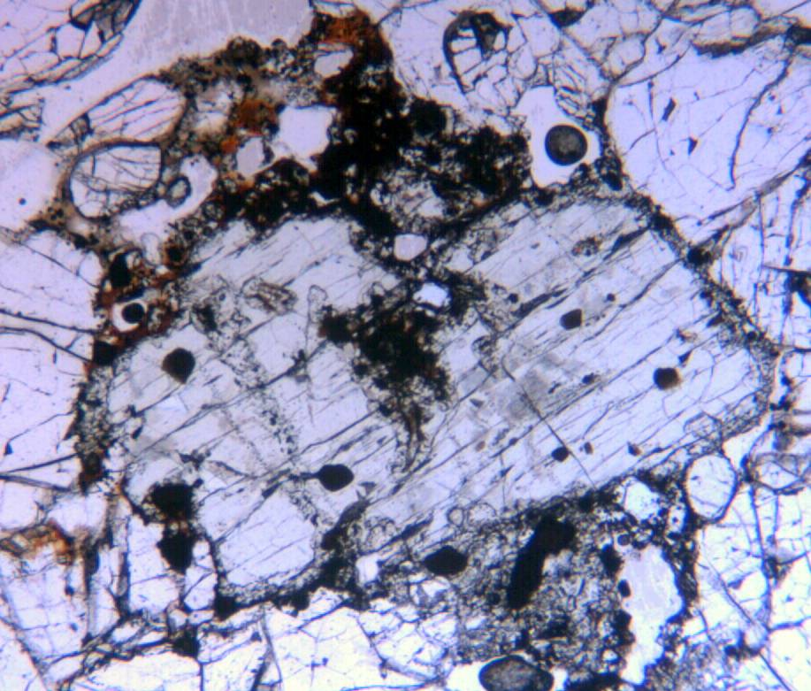
How a simple mantle melts
Polybaric, near-fractional melting of lherzolite
Some natural examples from Italy
Ol
Ol
Also here cpx is rimmed by a glassy brown jacket plus spinels.
Ol
Cpx
Cpx
Ol
Ol

Slide 89
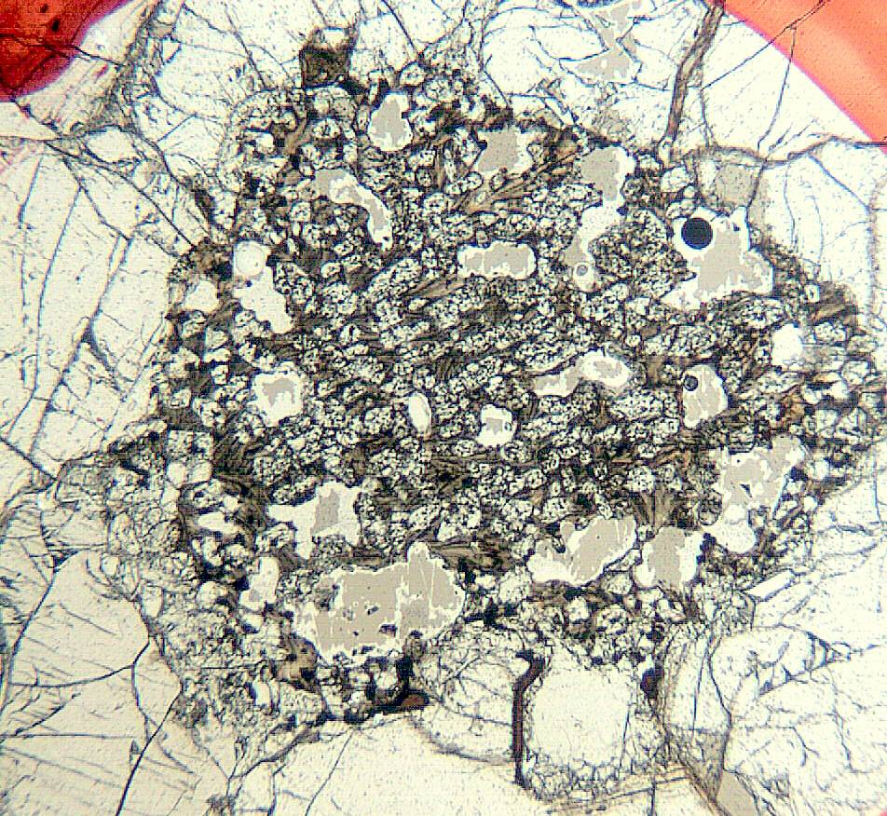
How a simple mantle melts
Polybaric, near-fractional melting of lherzolite
Some natural examples from Italy
In this case the cpx is completely spongy.
Ol
Ol
Ol
This type of microstructure is called “pyrometamorphic”.
Cpx is nearly completely transformed to brown glass, spinel and euhedral olivine.
Ol
Cpx
Opx
Ol
Opx
Ol

Slide 90
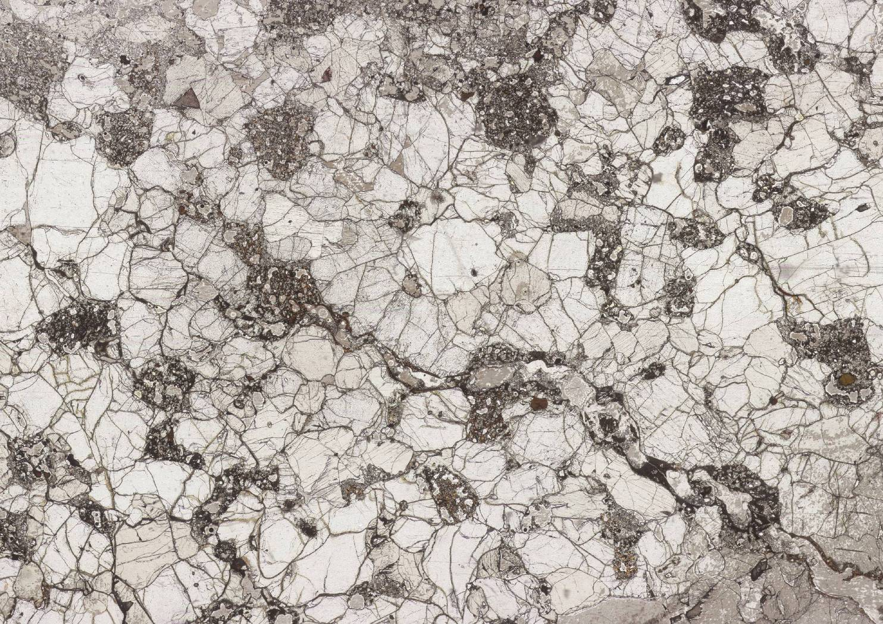
How a simple mantle melts
Polybaric, near-fractional melting of lherzolite
Some natural examples from Italy
Here olivine is outlined in black, opx in sky blue and the spongy clinopyroxene is shown in red.

Slide 91
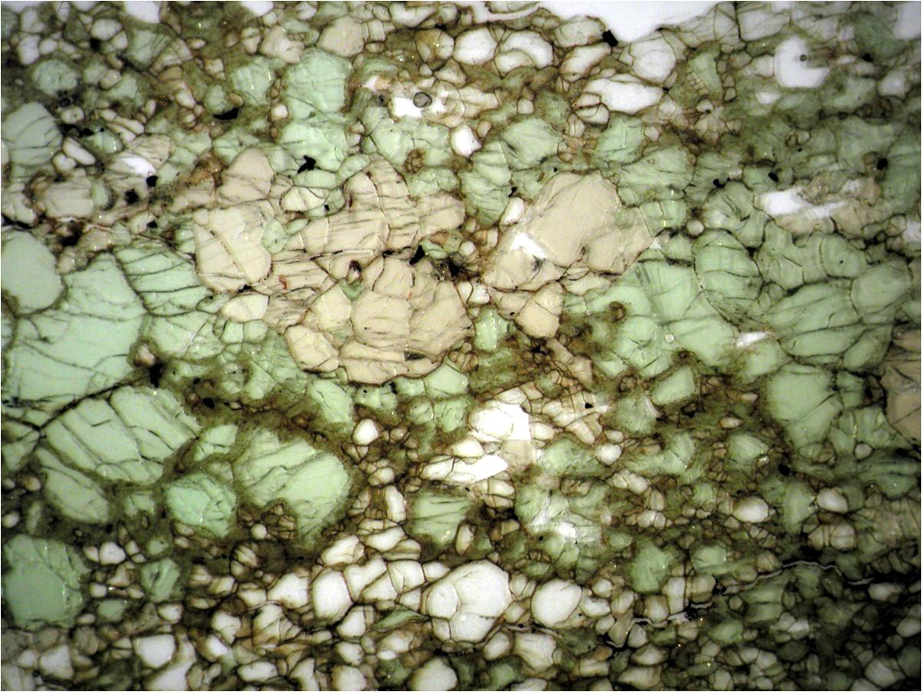

Slide 92
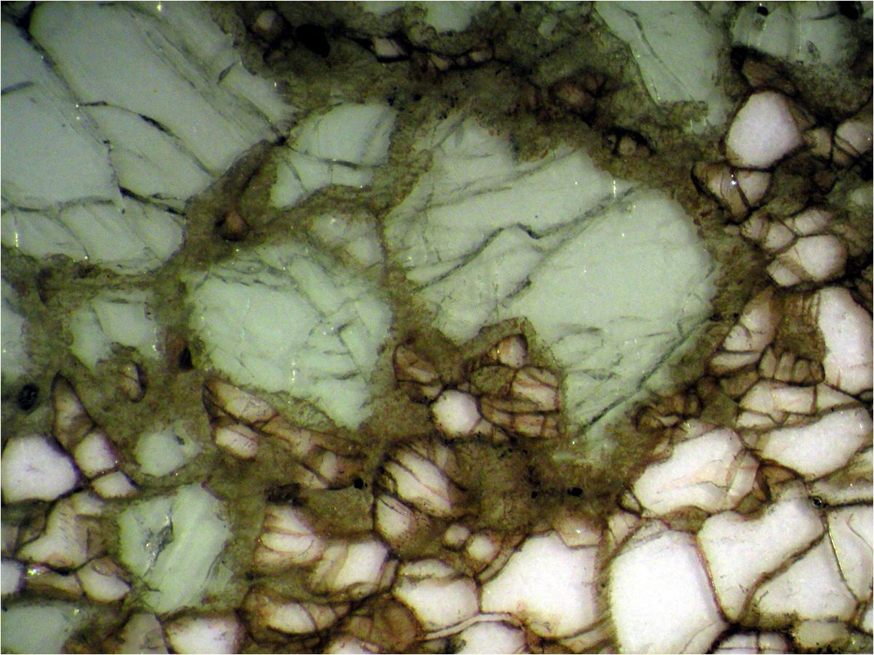

Slide 93
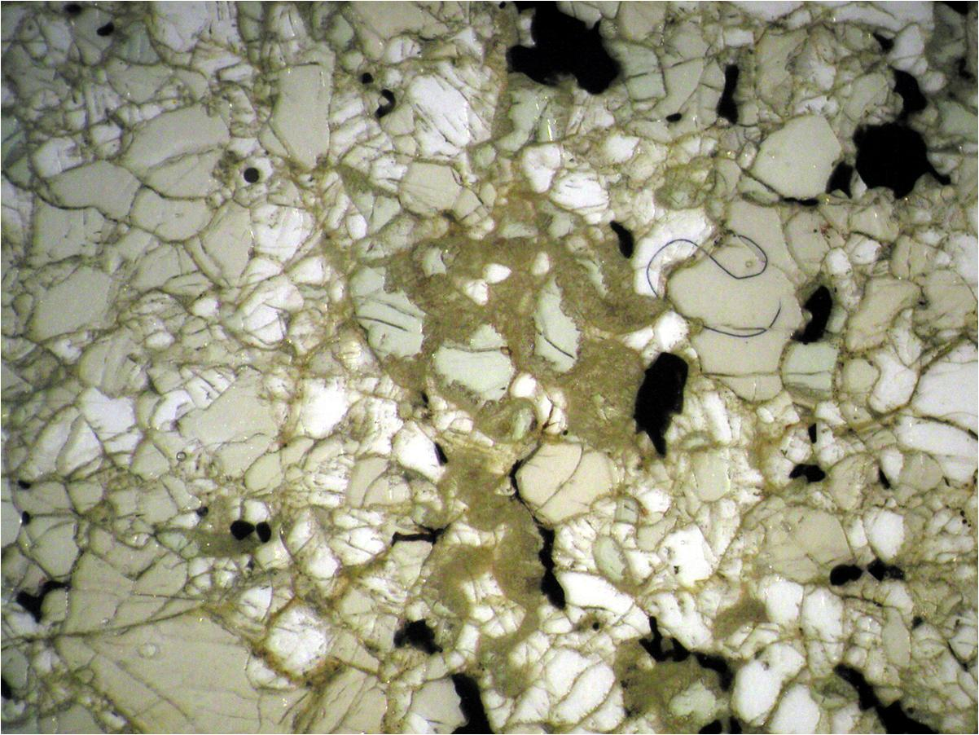

Slide 94
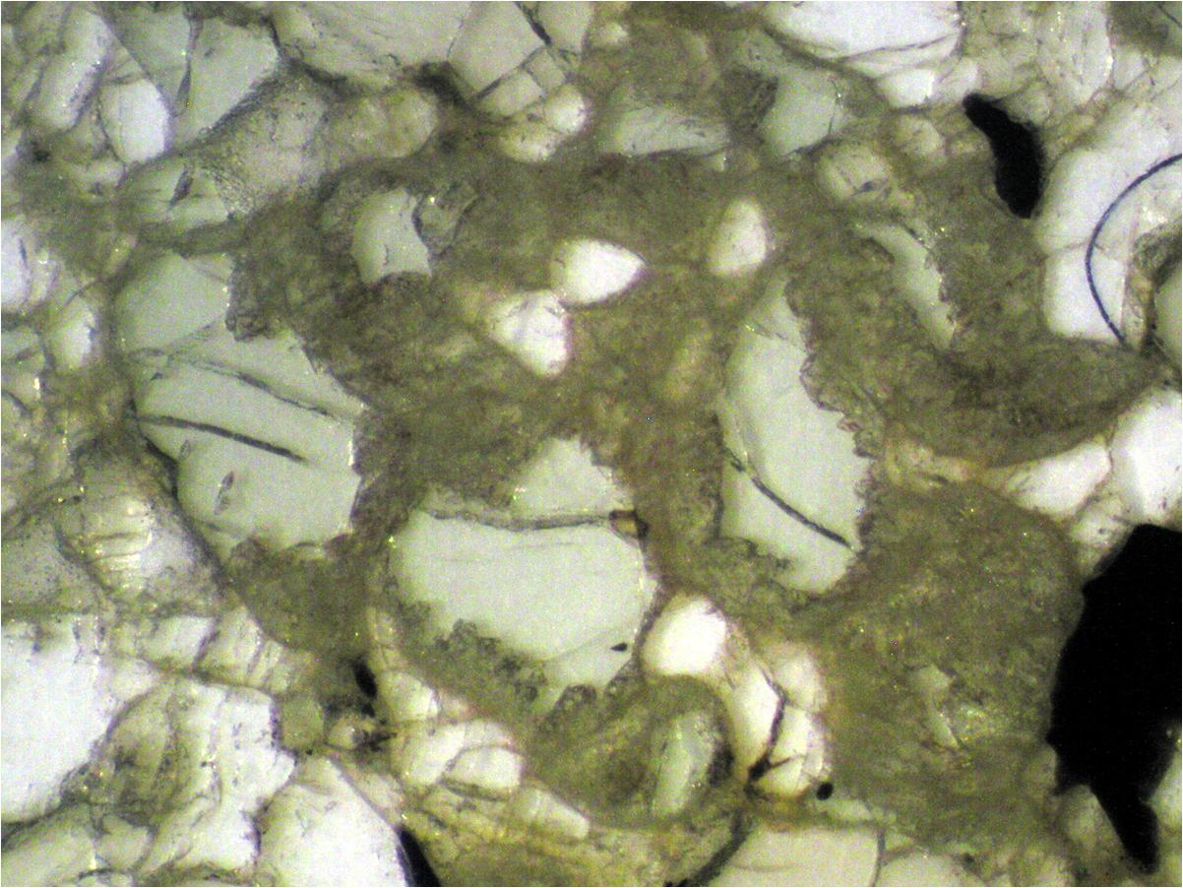

Slide 95
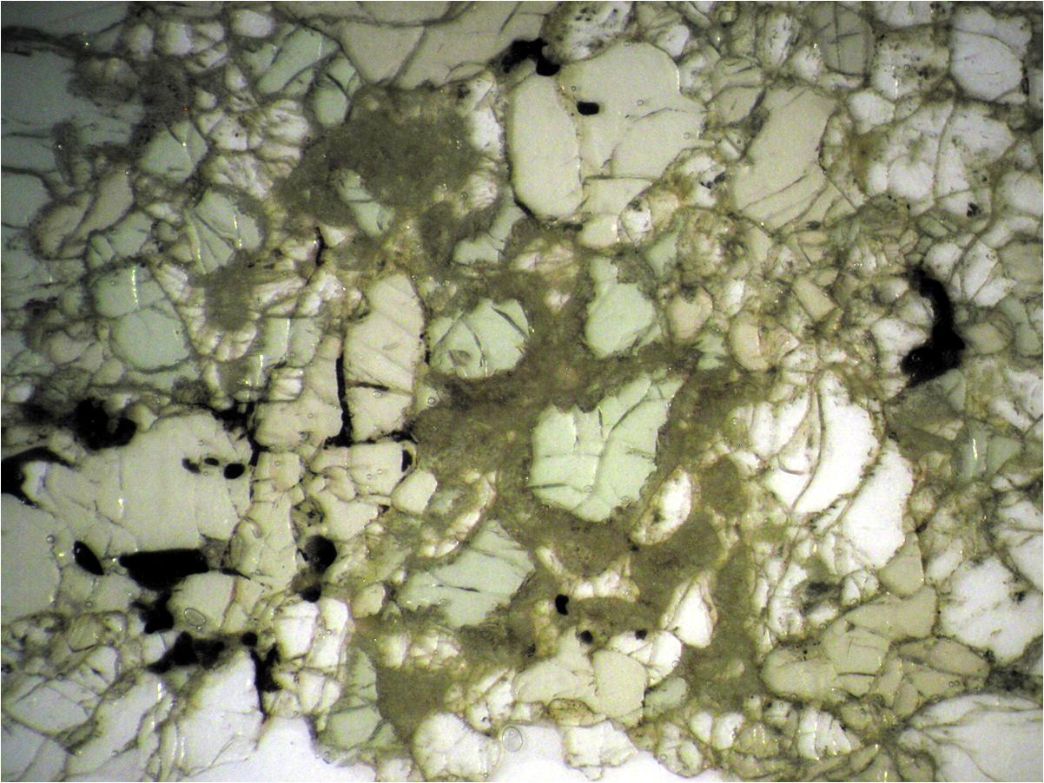

Slide 96
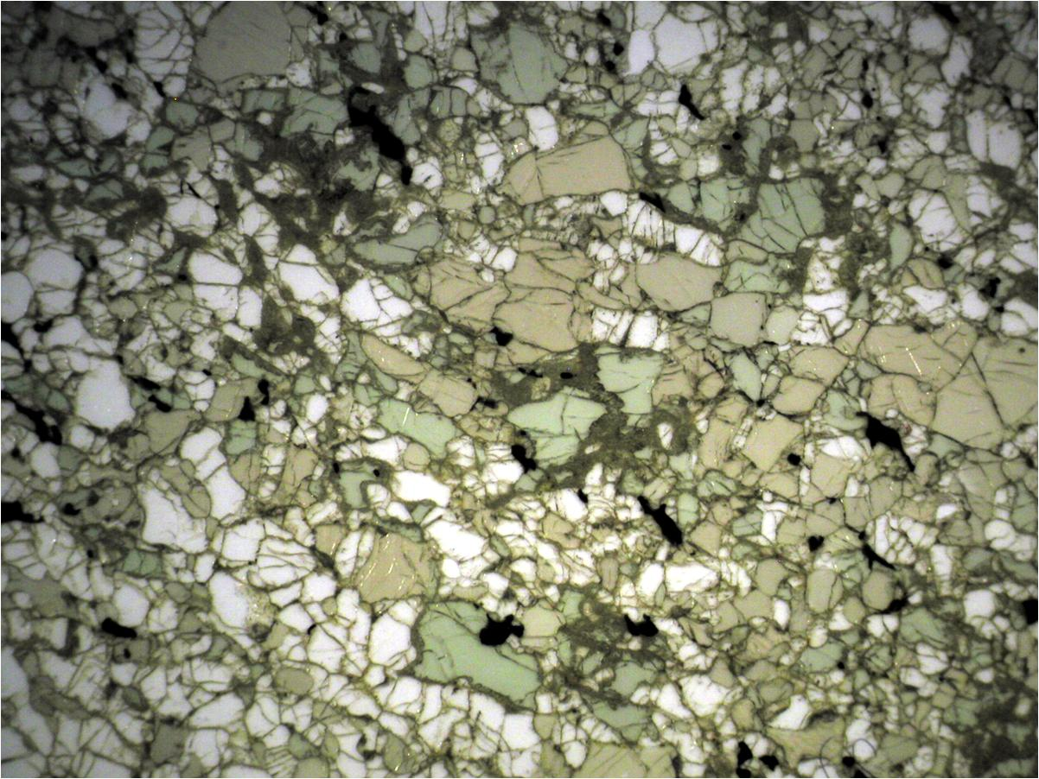

Slide 97
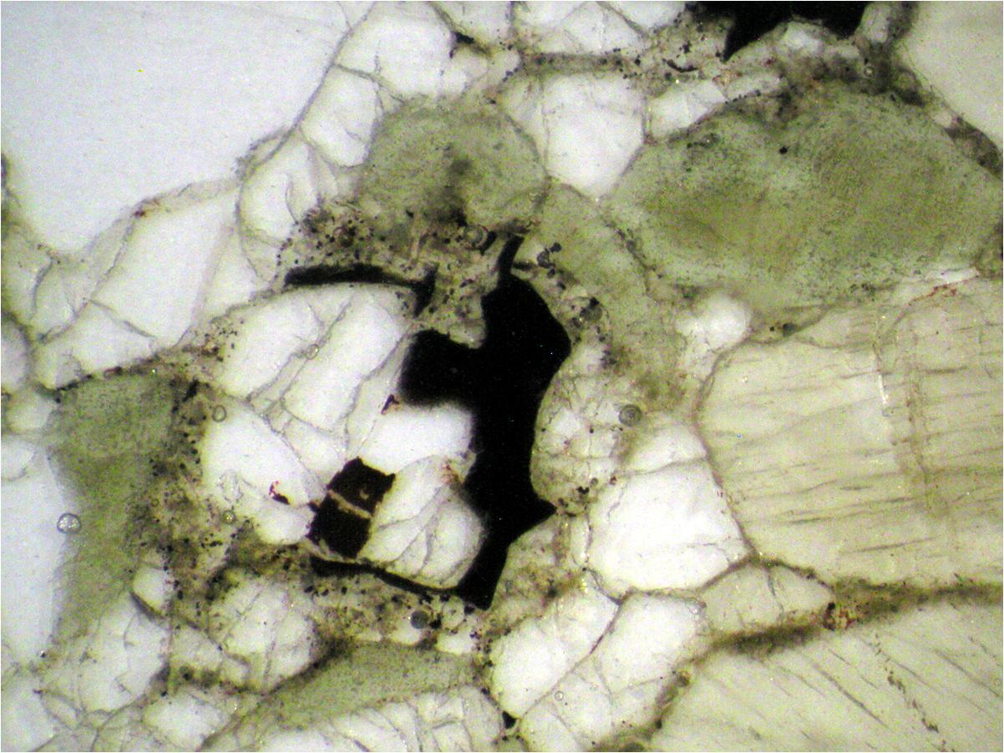

Slide 98
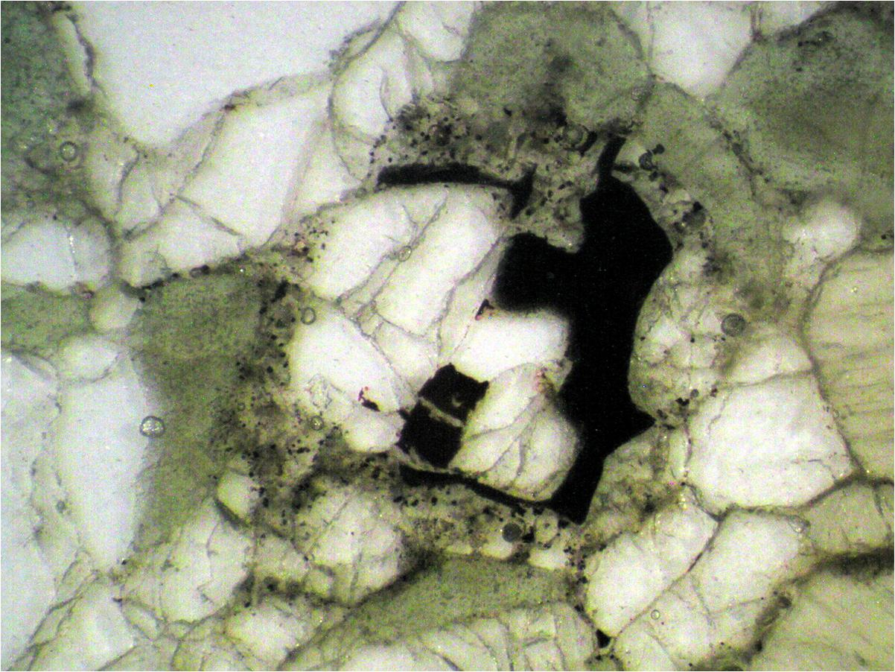

Slide 99
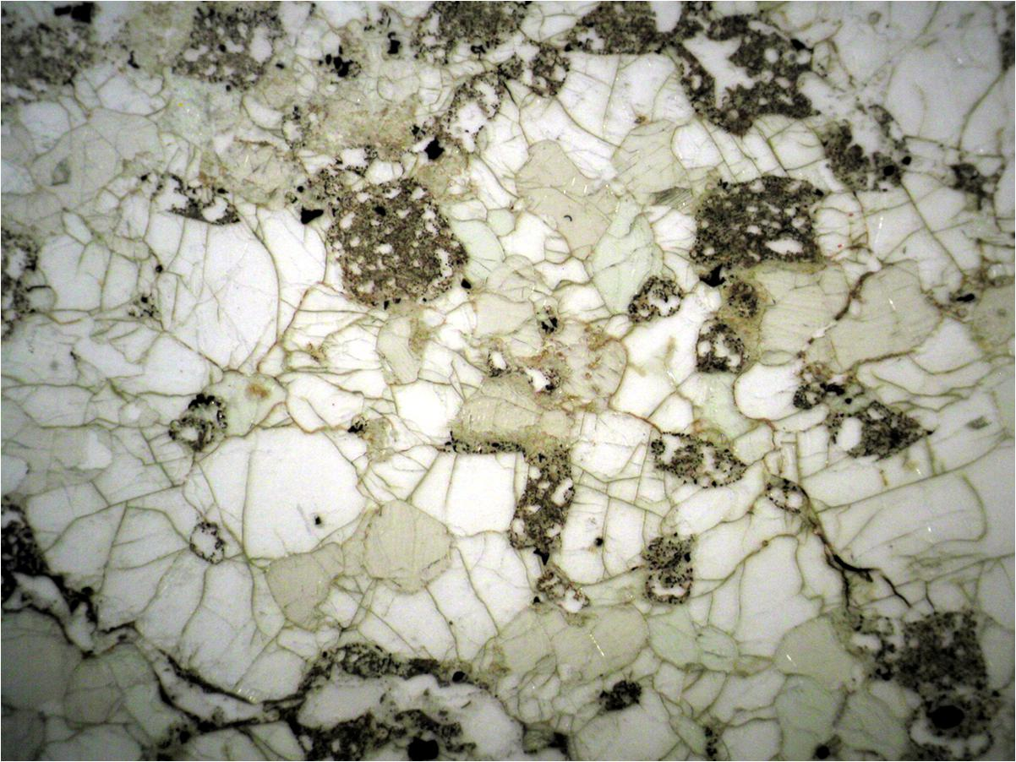

Slide 100
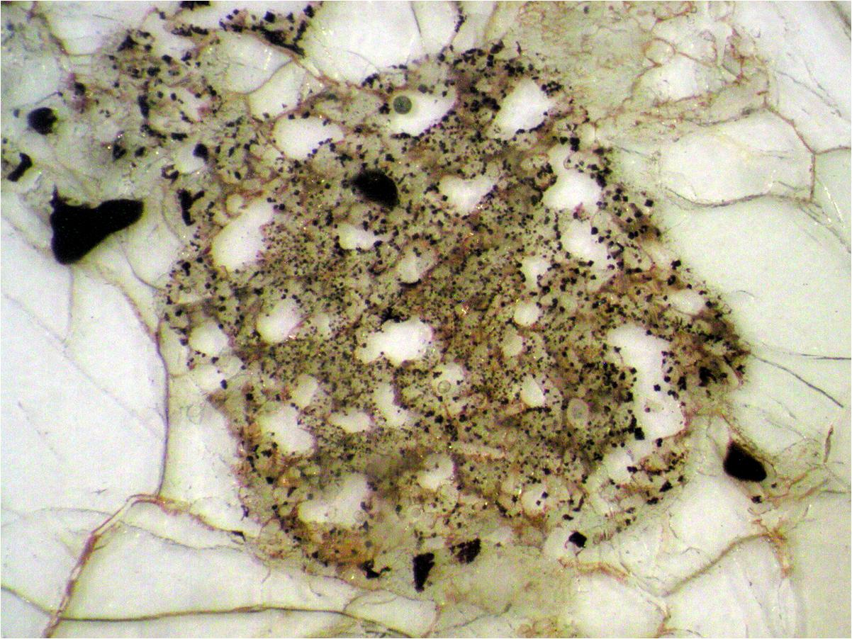

Slide 101
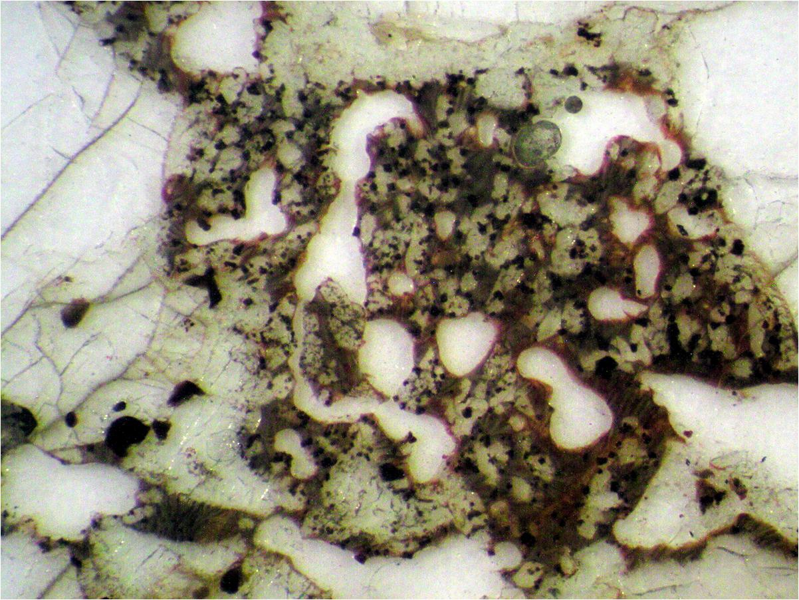

Slide 102
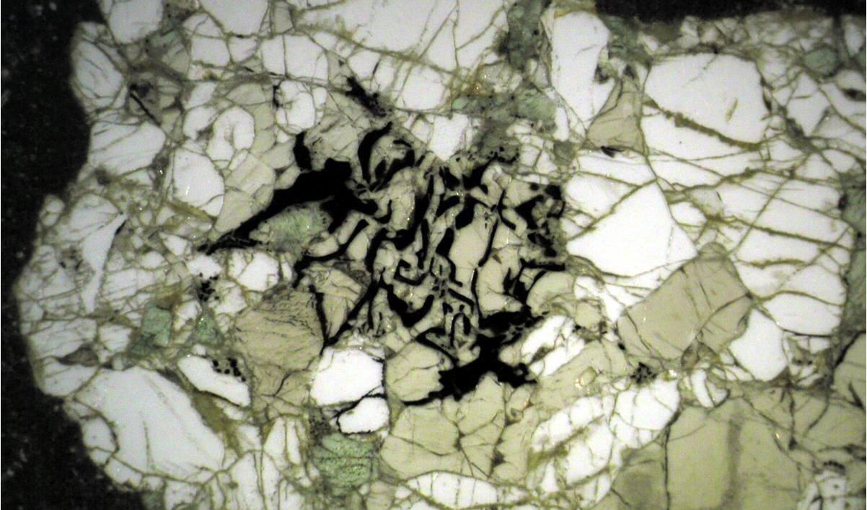
Here we see sp + opx after garnet
Former gt
Ol
Ol
Cpx
Opx
Ol
Opx
Sp
Sp
Ol
Cpx
Ol
Opx
Opx
Opx
Sp
Opx
Cpx
Opx
Ol
Opx
Sp
Ol
Opx
Cpx
Opx
MgAl₂O₄ + 2Mg₂Si₂O₆ = Mg₂SiO₄ + Mg₃Al₂Si₃O₁₂
Noble Spinel
Enstatite
Forsterite
Pirope
Spinel
Opx
Olivine
Garnet

Slide 103
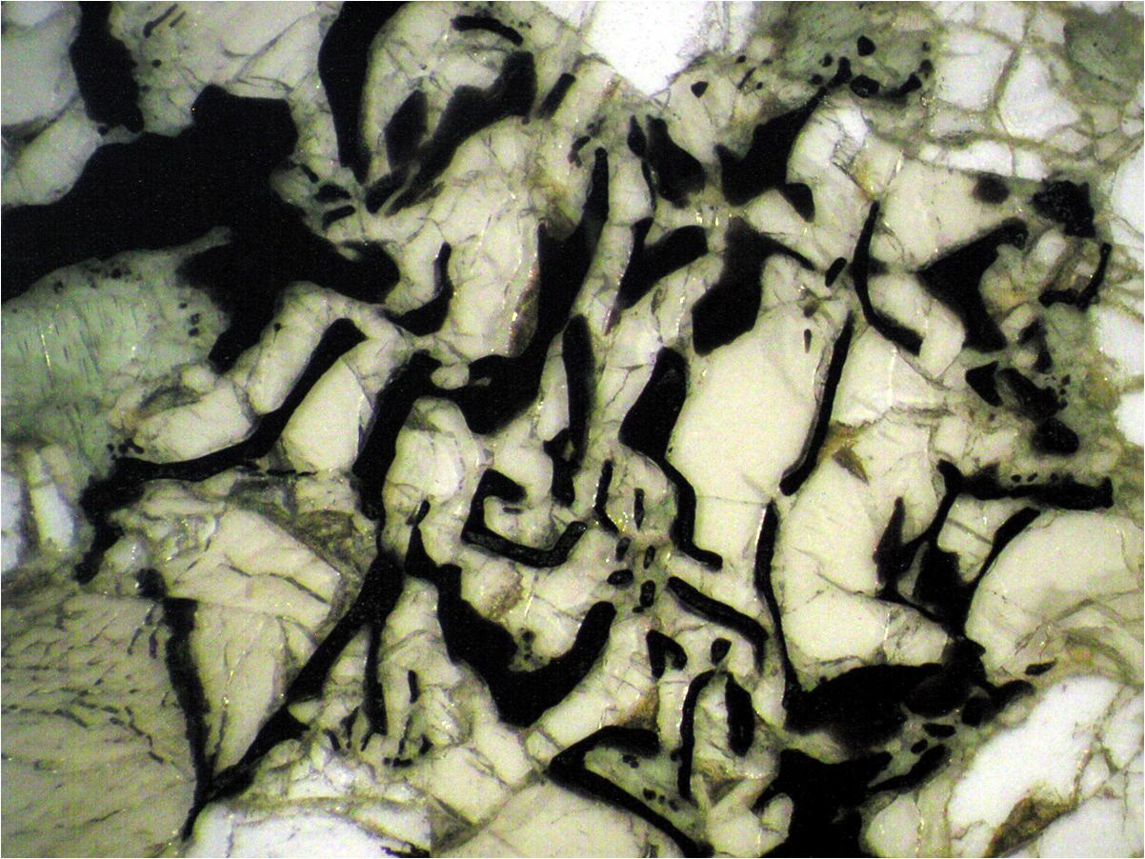

Slide 104
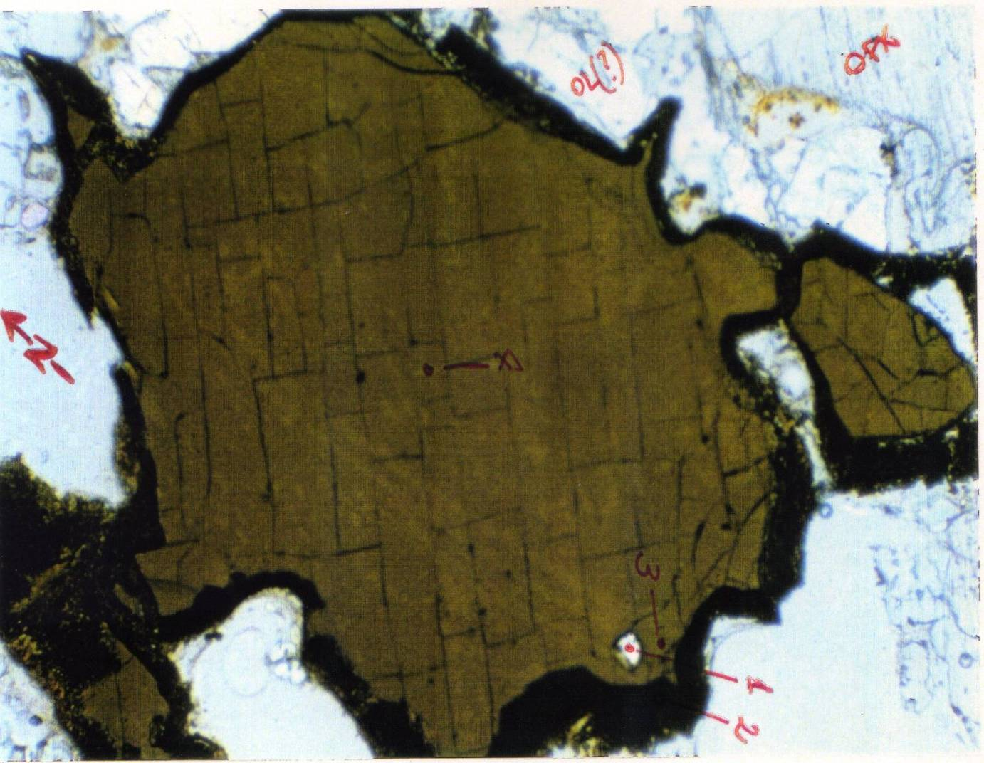
How a simple mantle melts
Polybaric, near-fractional melting of lherzolite
Some natural examples from Italy
This is a spinel in a spinel-facies mantle xenolith in a Pliocene hawaiite from Sardinia.
It is characterized by a spongy rim.
Zoom in.
Spinel

Slide 105
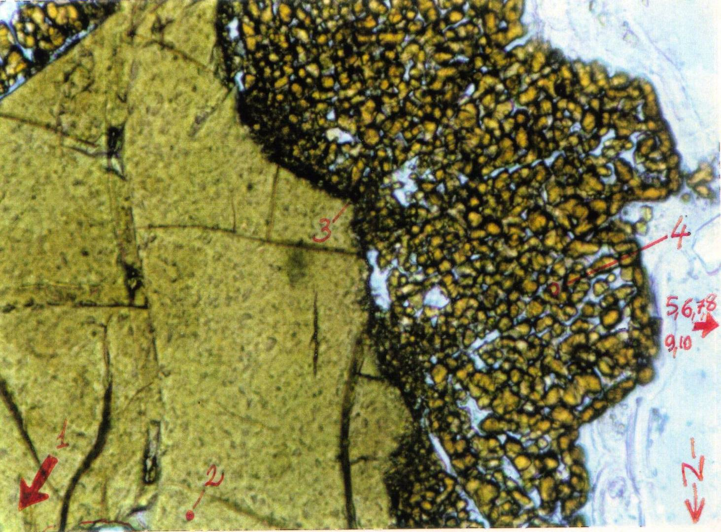
How a simple mantle melts
Polybaric, near-fractional melting of lherzolite
Some natural examples from Italy
This is a clear petrographic evidence that spinel is participating in the melting assemblage.
Spongy rim of spinel
Spinel relict

Slide 106
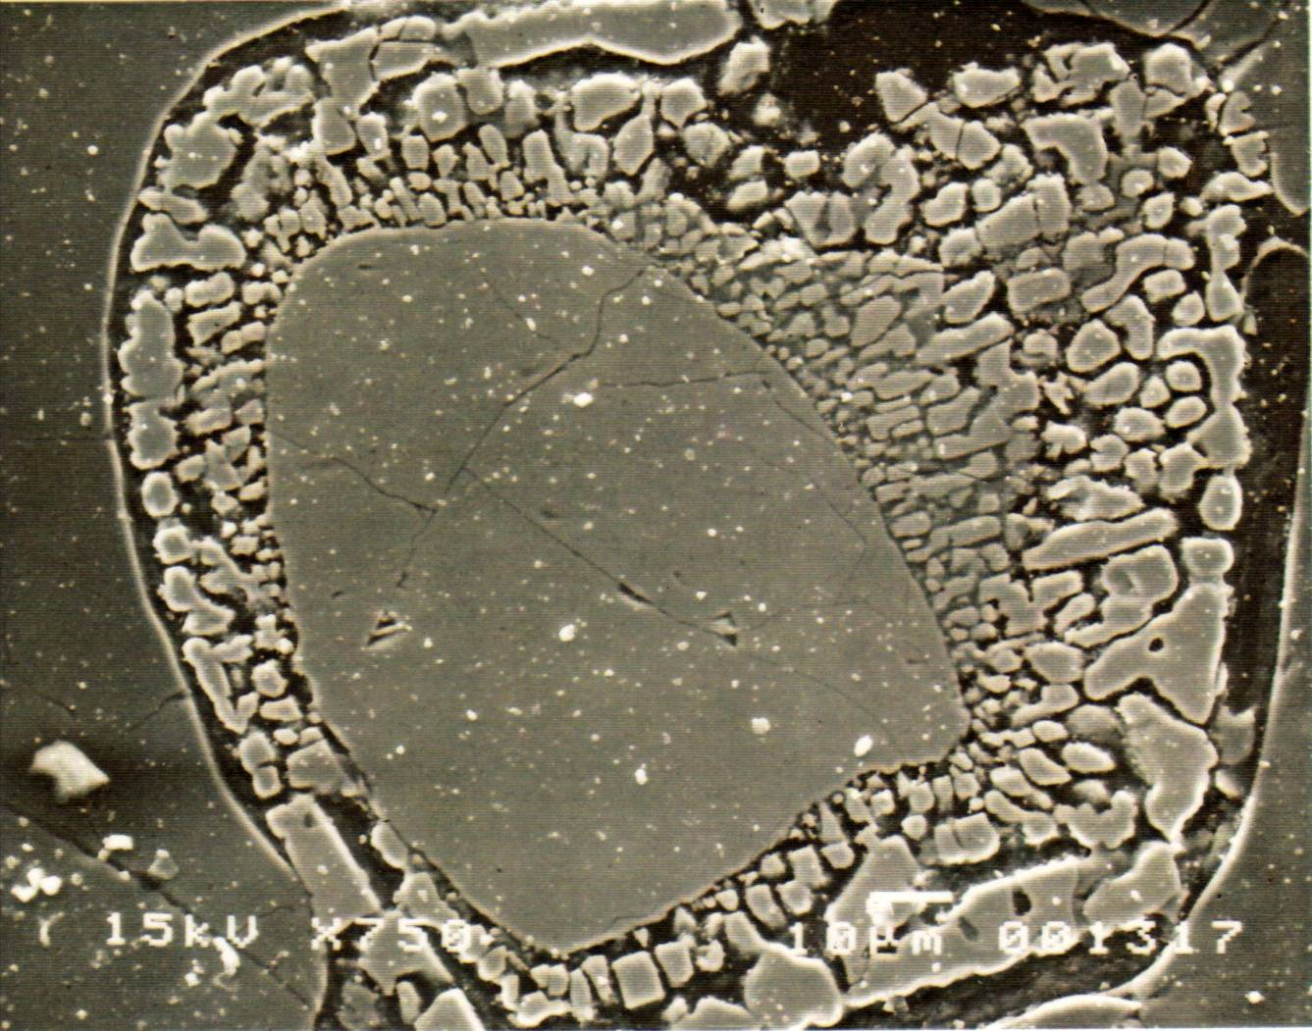
How a simple mantle melts
Polybaric, near-fractional melting of lherzolite
Some natural examples from Italy
This is a back-scattered image showing a relict spinel core rimmed by a spongy border experiencing incipient melting.
Spongy rim of spinel
Spinel relict

Slide 107
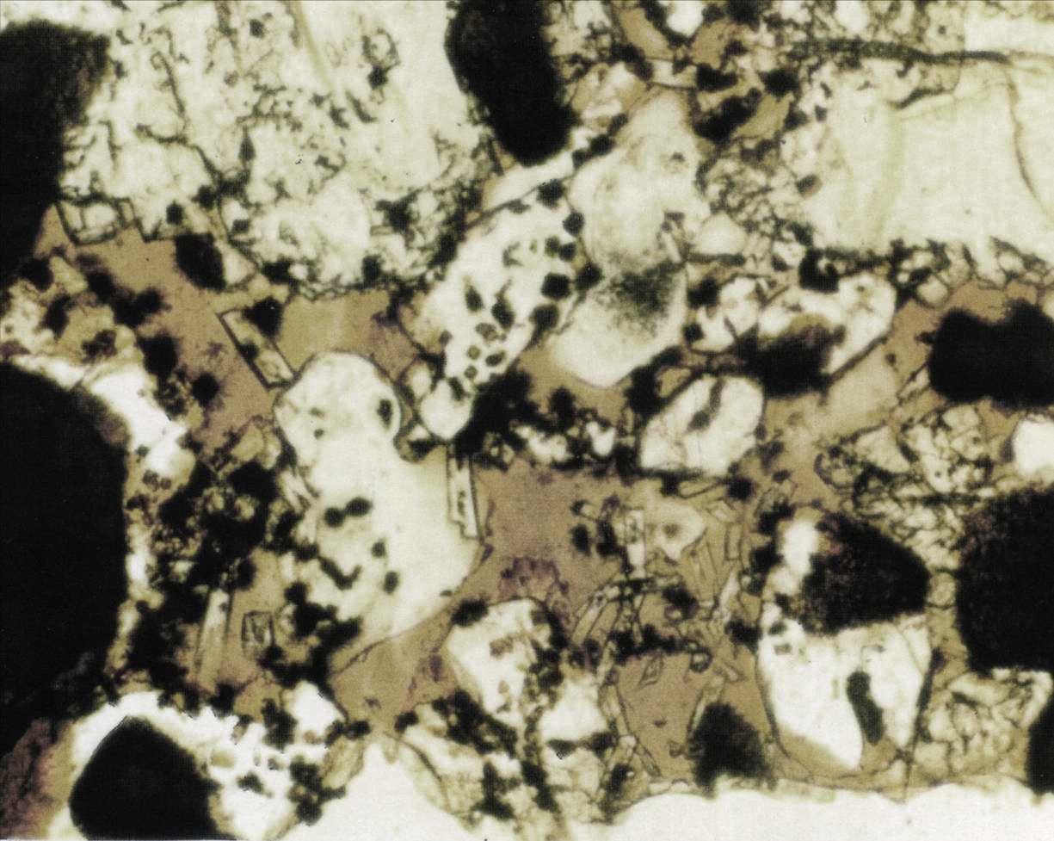
How a simple mantle melts
Polybaric, near-fractional melting of lherzolite
Some natural examples from Italy
This is a zoom of the glassy pocket developing around cpx and spinel.
What do you see?
Brown glass + euhedral new cpx + euhedral new olivine + euhedral new sp.
Glass
Glass
Glass
Glass
10 mm

Slide 108
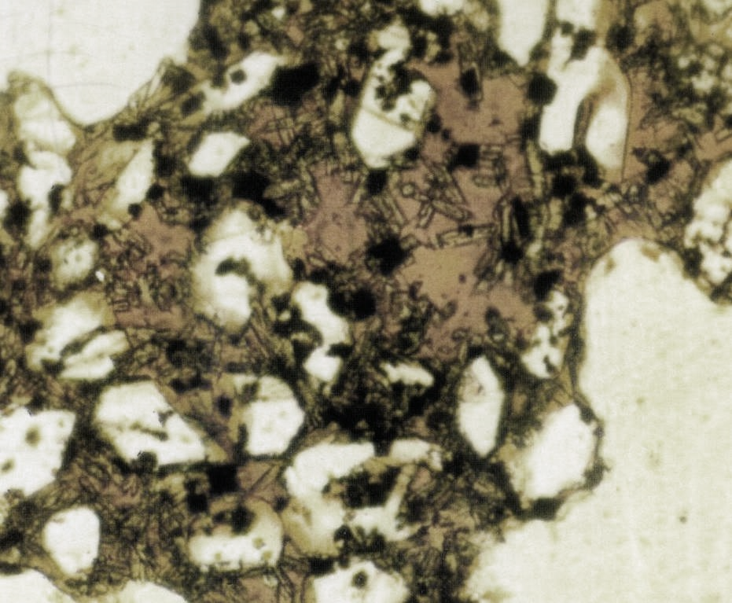
How a simple mantle melts
Polybaric, near-fractional melting of lherzolite
Some natural examples from Italy
Again:
Glassy pocket with
Brown glass + euhedral new cpx + euhedral new olivine + euhedral new spinel.
Glass
Glass
50 mm

Slide 109
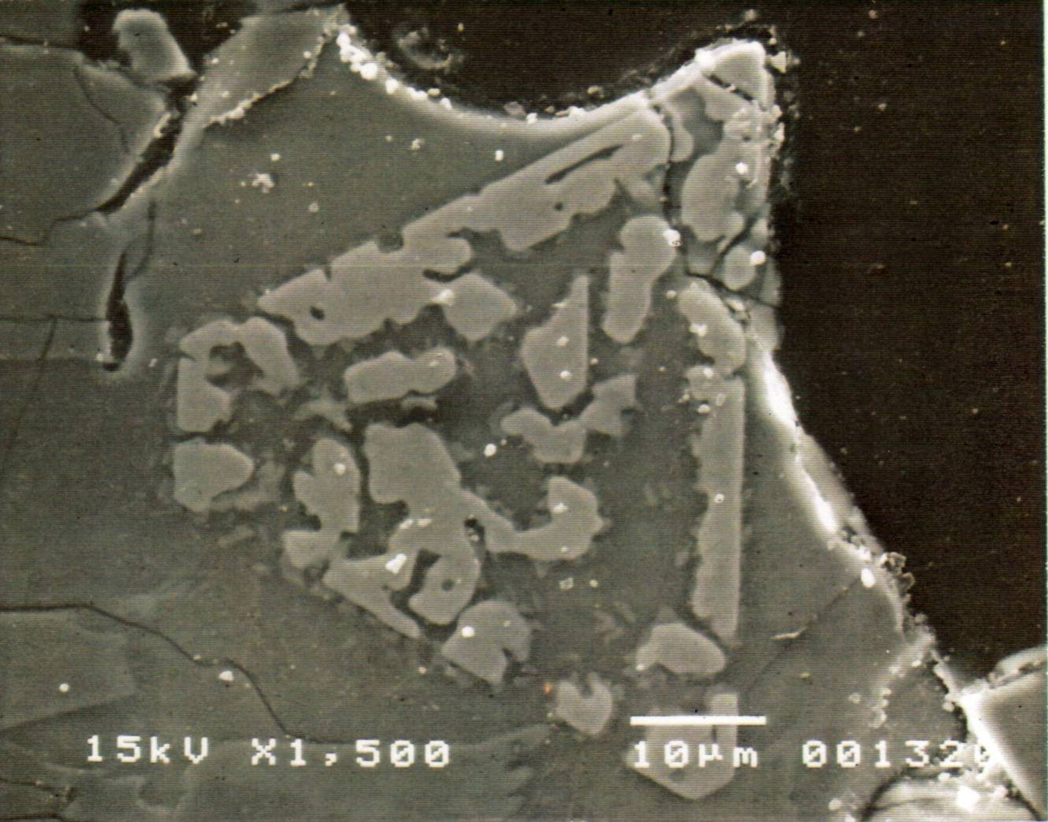
How a simple mantle melts
Polybaric, near-fractional melting of lherzolite
Some natural examples from Italy
Euhedral skeletal spinel crystallizing from a basaltic melt derived by the decompression melting of cpx + spinel.

Slide 110
How a simple mantle melts
Polybaric, near-fractional melting of lherzolite
Some natural examples from Italy
These petrographic characteristics were geochemically mass-balanced to obtain a melting equation of the type:
6.9Cpx₍₁₎ + 0.6Sp₍₁₎ =
3.5Cpx₍₂₎ + 0.6Sp + 0.1Ol + 1.0Glass
In this case opx seems not to participate in the melting assemblage.
Lustrino et al., 1999 (Per. Mineral., 68, 13-42)

Slide 111
How a simple mantle melts
Polybaric, near-fractional melting of lherzolite
Whathever is the more correct model for explaining the melting mode of mantle minerals, one feature for sure is the rule of mantle melting at relatively shallow P:
The incongruent melting of orthopyroxene.

Slide 112
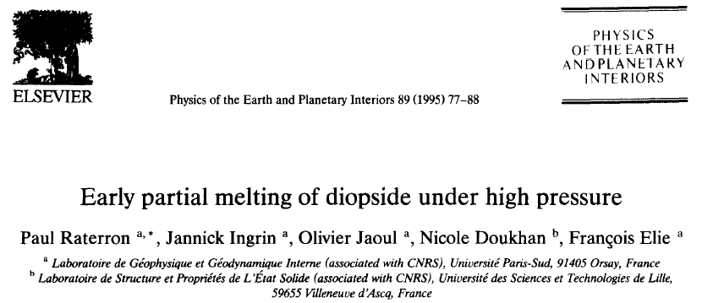
How a simple mantle melts
Polybaric, near-fractional melting of lherzolite
To be honest, the true things are even more complex than what is shown here…
Indeed, about 15 years ago some researchers detected that also clinopyroxene (diopside) may melt incongruently giving SiO₂-enriched melts…

Slide 113
How a simple mantle melts
Polybaric, near-fractional melting of lherzolite
These experiments have shown that Early Partial Melting (EPM) in pyroxenes begins by the precipitation of tiny droplets (0.1/mm or less) of a molten phase highly enriched in silica. At room pressure, EPM starts at temperatures markedly lower than the pyroxene solidus temperatures approximately (250°C below).

Slide 114
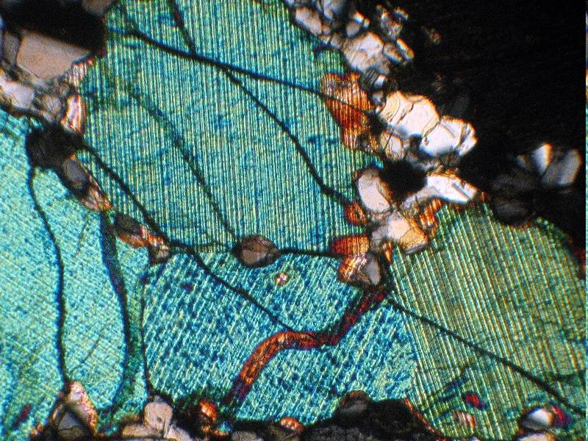
How a simple mantle melts
Polybaric, near-fractional melting of lherzolite
But now focus our attention on the classical incongruent melting of enstatite only.

Slide 115
P₀>P₁>P₂>P₃
For the moment do not consider the congruent melting of Opx
P₀
R₀
P
P₀
Res₀
P₁
Opx = Ol + SiO₂
P₂
P₃
P₁
P₀
P/E
P₁
R₁
E
P₂
Res₁
P₃
P₂
Ol+L
Decompression Melting
T
R₂
P
Res₂
Opx+L
SiO₂+L
E
Ol+Opx
Opx+SiO₂
P₃
R₃
Ol
Opx
SiO₂
Res₃
Niu, 1997 (J. Petrol., 38, 1047-1074)
Ol
Opx
SiO₂

Slide 116
How a simple mantle melts
P₁ > P₂ > P₃
Cpx
P₁
Melt compositions at R₁, R₂ and R₃
at pressures P₁ > P₂ > P₃
R₁
Res₁
P₂
Cpx
Phase Volume
Decompression Melting
R₂
Res₂
R₂
R₃
R₁
P₃
Olivine
Phase Volume
Opx
Phase Volume
R₃
Ol
Opx
Res₃
Niu, 1997 (J. Petrol., 38, 1047-1074)
Ol
Opx
SiO₂

Slide 117

Mantle melting, melt extraction and post-melting processes beneath mid-ocean ridges
Let’s see now how the major element composition of the mantle residuum varies with varying degrees of melting.
Something of strange happens.
These “strange” or “unexpected” features have been discovered not many years ago.

Slide 118
Mantle melting, melt extraction and post-melting processes beneath mid-ocean ridges
Simple melting residues calculated by models of polybaric near fractional melting (1% melt porosity) with initial melting depths of P₀ = 15 and 25 kbar, and of isobaric batch melting at P = 10 and 20 kbar.
The MgO content of the residuum is considered to be proportional to the degree of partial melting
Niu, 1997 (J. Petrol., 38, 1047-1074)

Slide 119
Mantle melting, melt extraction and post-melting processes beneath mid-ocean ridges
Abyssal peridotite compositions from different localities.
At a given MgO, Ti and Na are higher than calculated in residues, but closer to batch melting than fractional melting.
Si is much lower, and Fe is much higher than expected for simple residues.
The positive MgO–FeO correlation indicates that abyssal peridotites are not simple residues.

Slide 120
Mantle melting, melt extraction and post-melting processes beneath mid-ocean ridges
MgO variation diagrams of SiO₂ and FeO for both data and model residues as in previous figure.
Here is plotted also the mean composition of olivine in abyssal peridotites with 2σ variations ( ).
Clearly, the trends defined by most data points are consistent with olivine addition.
Niu, 1997 (J. Petrol., 38, 1047-1074)

Slide 121
Mantle melting, melt extraction and post-melting processes beneath mid-ocean ridges
The fields enclosed by the dashed lines are where the mixtures of olivine and simple residues plot, with the simple residues being produced by varying degrees of melting from a single source composition (e.g., the preferred source, blue square).
Niu, 1997 (J. Petrol., 38, 1047-1074)

Slide 122
Mantle melting, melt extraction and post-melting processes beneath mid-ocean ridges
Did you really understand how is olivine addition possible?
A melt formed at P₁, when brought to shallower depths (P₂) encounters olivine as liquidus phase, therefore it starts to crystallize it during cooling.
High P
R₁
Harz.
Low P
R₂
Harz.
Ol
Opx
SiO₂

Slide 123

Mantle melting, melt extraction and post-melting processes beneath mid-ocean ridges
Let’s see now how the trace element composition of the mantle residuum varies with varying degrees of melting.
Also in this case something of strange happens.

Slide 124
Mantle melting, melt extraction and post-melting processes beneath mid-ocean ridges
Among all the residual phases (ol, opx, cpx and sp), cpx has the highest incompatible element mineral/melt partition coefficients.
Partition Coefficient
C_{S}
C_{L}
i
i
K_{D} =
_{S}
i
C_{S}
i
= Concentration of element i in the mineral.
= Concentration of element i in the melt in equilibrium with that mineral.
i
C_{L}

Slide 125
Mantle melting, melt extraction and post-melting processes beneath mid-ocean ridges
Among all the residual phases (ol, opx, cpx and sp), cpx has the highest incompatible element mineral/melt partition coefficients.
A given element may have different Kd depending the mineral where it enters.
(e.g., Kd^{La}_{Cpx} ≠ Kd^{La}_{Ol} ≠ Kd^{La}_{Gt})
A given mineral may have different Kd depending on the elements considered.
(e.g., Kd^{La}_{Cpx} ≠ Kd^{Ni}_{Cpx} ≠ Kd^{Sc}_{Cpx})

Slide 126
Mantle melting, melt extraction and post-melting processes beneath mid-ocean ridges
Among all the residual phases (ol, opx, cpx and sp), cpx has the highest incompatible element mineral/melt partition coefficients.
Let us deal for a moment with one of the most important groups of elements in igneous petrology:
The Rare Earth Elements (REE)
La, Ce, Pr, Nd, Sm, Eu, Gd, Tb, Dy, Ho, Er, Tm, Yb, Lu
Typically, the Kd values of REE in classical mantle minerals increases from La (LREE) to Lu (HREE)

Slide 127
Mantle melting, melt extraction and post-melting processes beneath mid-ocean ridges
Among all the residual phases (ol, opx, cpx and sp), cpx has the highest incompatible element mineral/melt partition coefficients.
What does this mean?
(Kd^{REE} increasing from La to Lu?)
LREE (e.g., La) are typically more incompatible than HREE (e.g., Lu).

Slide 128
Mantle melting, melt extraction and post-melting processes beneath mid-ocean ridges
Among all the residual phases (ol, opx, cpx and sp), cpx has the highest incompatible element mineral/melt partition coefficients.
i.e., during partial melting La leaves the solid (mineral) more easier than other REE (e.g., HREE).
This means that the residuum is more depleted in La than in other REE.

Slide 129
Mantle melting, melt extraction and post-melting processes beneath mid-ocean ridges
Among all the residual phases (ol, opx, cpx and sp), cpx has the highest incompatible element mineral/melt partition coefficients.
Low
Extremely Low
LREE
LREE
LREE
LREE
K_{D}
>
K_{D}
~
K_{D}
~
K_{D}
_{Cpx}
_{Opx}
_{Ol}
_{Sp}
~0.01-0.2
~0.0005-0.05
LREE (e.g., La) are all incompatible in typical mantle minerals. LREE are sligthly less incompatible in Cpx.

Slide 130
Mantle melting, melt extraction and post-melting processes beneath mid-ocean ridges
Among all the residual phases (ol, opx, cpx and sp), cpx has the highest incompatible element mineral/melt partition coefficients.
Low
Extremely Low
LREE
LREE
LREE
LREE
K_{D}
>
K_{D}
~
K_{D}
~
K_{D}
_{Cpx}
_{Opx}
_{Ol}
_{Sp}
I.e., during partial melting, Sp, Ol and Opx expel REE more than Cpx.
In the residuum, Cpx is richer in REE than other phases.

Slide 131
Mantle melting, melt extraction and post-melting processes beneath mid-ocean ridges
The easiest way to model the behaviour of trace elements during partial melting processes is the classical equation of Shaw (1970):
C_{L} = C₀/[D+F(1-P)]
C_{L} = composition of an element in the liquid
C_{o} = composition of the same element in the source
D = Bulk distribution coefficient in the source (ΣK_{D})
F = Degree of partial melting
P = Bulk distribution coefficient in the phases entering the melt (ΣK_{D})

Slide 132
Mantle melting, melt extraction and post-melting processes beneath mid-ocean ridges
In what case is there a numerical difference between D and P?
C_{L} = C₀/[D+F(1-P)]
C_{L} = composition of an element in the liquid
C_{o} = composition of the same element in the source
D = Bulk distribution coefficient in the source (ΣK_{D})
F = Degree of partial melting
P = Bulk distribution coefficient in the phases entering the melt (ΣK_{D})

Slide 133
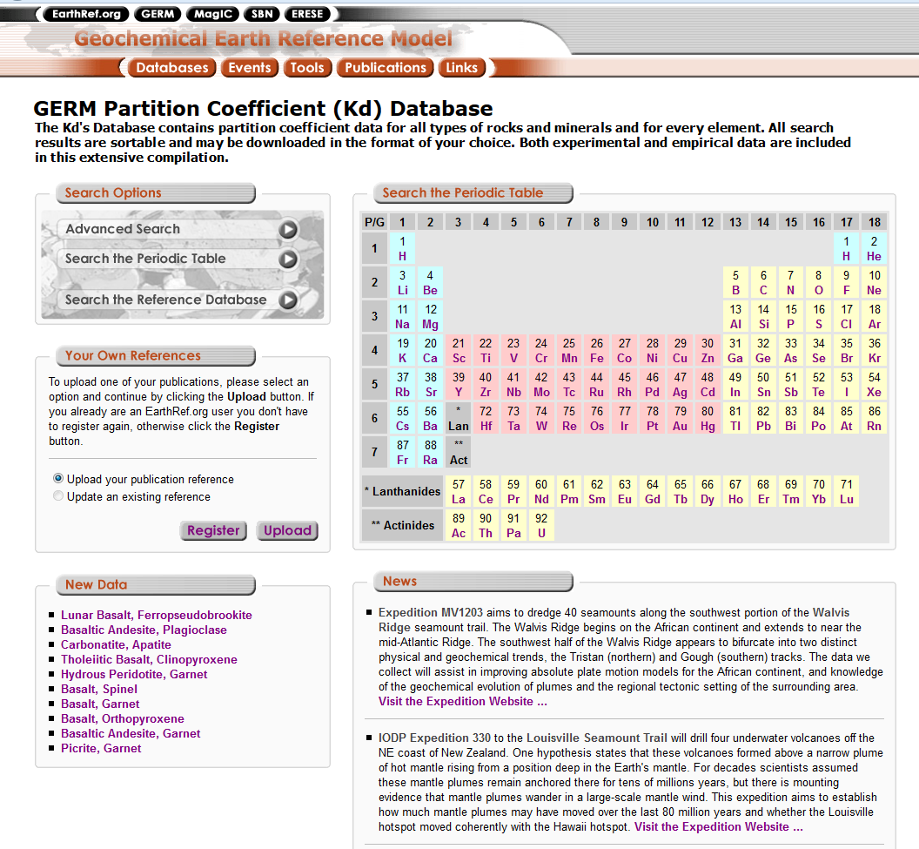
https://earthref.org/KDD/

Slide 134
Mantle melting, melt extraction and post-melting processes beneath mid-ocean ridges
Now let us make some very simple geochemical model working with MS Excel spreadsheets
Let us try to model (or reproduce) the trace-element content of a mantle-derived melt and a mantle residuum.
Exercise #2 (Trace-element modelling)

Slide 135
Mantle melting, melt extraction and post-melting processes beneath mid-ocean ridges
In a mantle peridotitic assemblage, cpx is the main carrier of incompatible trace elements.
This does not mean that cpx is a good host for incompatible elements.
It is just the least bad place.
From: Niu (2004) J. Petrol., 45, 2423-2458

Slide 136
Mantle melting, melt extraction and post-melting processes beneath mid-ocean ridges
Residual ol, opx, and sp in equilibrium with the cpx should have lower LREE abundances than the cpx.
WHY?
Because LREE are more incompatible in ol, opx and sp compared to cpx.
From: Niu (2004) J. Petrol., 45, 2423-2458

Slide 137
Mantle melting, melt extraction and post-melting processes beneath mid-ocean ridges
This means that bulk-rock samples (modal cpx <10 %) should have lower, not higher, LREE abundances than the cpx.
From: Niu (2004) J. Petrol., 45, 2423-2458

Slide 138
Mantle melting, melt extraction and post-melting processes beneath mid-ocean ridges
What we see here is unexpected (i.e., whole-rock LREE are more enriched, not more depleted, than in the constituent residual cpx of the same sample suites).
What does this mean?
Our present knowledge on the petrogenesis of abyssal peridotites in the context of ocean ridge processes is not yet complete.
?
Expected WR
Expected WR
Expected WR
Expected WR
Niu, 2004 (J. Petrol., 45, 2423-2458)

Slide 139
Mantle melting, melt extraction and post-melting processes beneath mid-ocean ridges
What is the origin of these unexpected results?
All these peridotites are serpentinized to various extents. Could the elevated abundances of LREE be due to serpentinization, a hydrothermal metamorphic process (250–400 °C), during which the LREE could be mobile and added in?
Average seawater has REE levels 4–6 orders of magnitude lower than in abyssal peridotites, so seawater cannot be a promising source for excess LREE in these rocks.
La
Pr
Sm
Gd
Dy
Er
Yb
Niu, 2004 (J. Petrol., 45, 2423-2458)
Ce
Nd
Eu
Tb
Ho
Tm
Lu

Slide 140
Mantle melting, melt extraction and post-melting processes beneath mid-ocean ridges
What is the origin of these unexpected results?
Seawater is the ultimate source for ridge hydrothermal fluids. Could hydrothermal fluids leach LREE out of the crustal lithologies and subsequently precipitate them during serpentinization atop the mantle?
No. Because of the strong correlation of REE with HFSE (which are not mobile in fluids).
La = REE
Nb = HFSE
La
Pr
Sm
Gd
Dy
Er
Yb
Ce
Nd
Eu
Tb
Ho
Tm
Lu

Slide 141
Mantle melting, melt extraction and post-melting processes beneath mid-ocean ridges
What is the origin of these unexpected results?
Possible solution:
Bulk-rock REE cannot be explained by melting models but can be explained by Post-Melting Refertilization

Slide 142
Mantle melting, melt extraction and post-melting processes beneath mid-ocean ridges
What is the origin of these unexpected results?
Geochemical modeling assuming two types of sources (DM and PM) and two types of melting processes (Batch and Fractional).
(Remember Excercise #2)
1 Islas Orcadas
2 Shaka
3 Atlantis
4 Vulcan
5 Bullard
6 Andrew Bain
7 Prince Edward
8 Bouvet
9 Indomed
10 Discovery
Niu, 2004 (J. Petrol., 45, 2423-2458)

Slide 143
Mantle melting, melt extraction and post-melting processes beneath mid-ocean ridges
What is the origin of these unexpected results?
Primitive Mantle-like starting compositions (PM) cannot give patterns like average values of natural abyssal peridotites both for Batch and Fractional Melting.
The same holds if the starting composition is depleted (DM).
La Ce Pr Nd Sm Eu Gd Tb Dy Ho Er Tm Yb Lu
La Ce Pr Nd Sm Eu Gd Tb Dy Ho Er Tm Yb Lu
Niu, 2004 (J. Petrol., 45, 2423-2458)

Slide 144
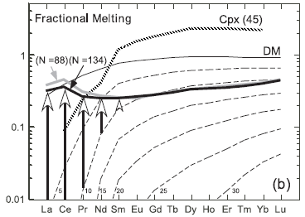
Mantle melting, melt extraction and post-melting processes beneath mid-ocean ridges
What is the origin of these unexpected results?
The elevated LREE abundances in bulk-rock abyssal peridotites can be readily explained by post-melting melt refertilization in the TBL.
Cpx
What can you say about the composition of an hypotetical Depleted Mantle partially melted to 5, 10, 15, 20, 25 and 30%?
DM
WR
5%
10
15%
20%
25%
30%

Slide 145
Mantle melting, melt extraction and post-melting processes beneath mid-ocean ridges
What is the origin of these unexpected results?
The elevated LREE abundances in bulk-rock abyssal peridotites can be readily explained by post-melting melt refertilization in the TBL.
1) All the REE are depleted (i.e., they are incompatible as a group).
2) LREE are more incompatible (more depleted) than MREE and HREE.
Cpx
DM
WR
5%
10
15%
20%
25%
30%

Slide 146
Mantle melting, melt extraction and post-melting processes beneath mid-ocean ridges
What is the origin of these unexpected results?
The elevated LREE abundances in bulk-rock abyssal peridotites can be readily explained by post-melting melt refertilization in the TBL.
The blue line (composition of a given peridotite) cannot be explained by simple partial melting of any DM or Primitive Mantle composition.
Cpx
DM
WR
5%
10
15%
20%
25%
30%

Slide 147
Mantle melting, melt extraction and post-melting processes beneath mid-ocean ridges
What is the origin of these unexpected results?
The elevated LREE abundances in bulk-rock abyssal peridotites can be readily explained by post-melting melt refertilization in the TBL.
It is possible to hypotesize the effects of metasomatic modifications of a depleted residuum.
Cpx
DM
WR
5%
10
15%
20%
25%
30%

Slide 148
Mantle melting, melt extraction and post-melting processes beneath mid-ocean ridges
What is the origin of these unexpected results?
The elevated LREE abundances in bulk-rock abyssal peridotites can be readily explained by post-melting melt refertilization in the TBL.
As an example, assume first 10% partial melting, followed by variable (hardly quantifiable) secondary processes re-enriching the residuum in incompatible elements.
Cpx
DM
WR
5%
10
15%
20%
25%
30%

Slide 149
Mantle melting, melt extraction and post-melting processes beneath mid-ocean ridges
What are the implications of this different view of MORB genesis?
1. The greater the ambient extent of mantle melting, the more melt is produced in the mantle. Thus, greater extents of melting lead to more olivine crystallization at shallow levels.

Slide 150
Mantle melting, melt extraction and post-melting processes beneath mid-ocean ridges
What are the implications of this different view of MORB genesis?
2. Neither MORB melts nor the bulk igneous crust are compositionally comparable with partial melts produced in peridotite melting experiments because primary mantle melts crystallize olivine back in the mantle.

Slide 151
Mantle melting, melt extraction and post-melting processes beneath mid-ocean ridges
What are the implications of this different view of MORB genesis?
3. Low-pressure melt equilibration during ascent is inevitable because the melting reaction preserved in residual peridotites requires continuous solid–liquid equilibration, and because olivine crystallization in the thermal boundary layer is the natural consequence of melt ascent and cooling.

Slide 152
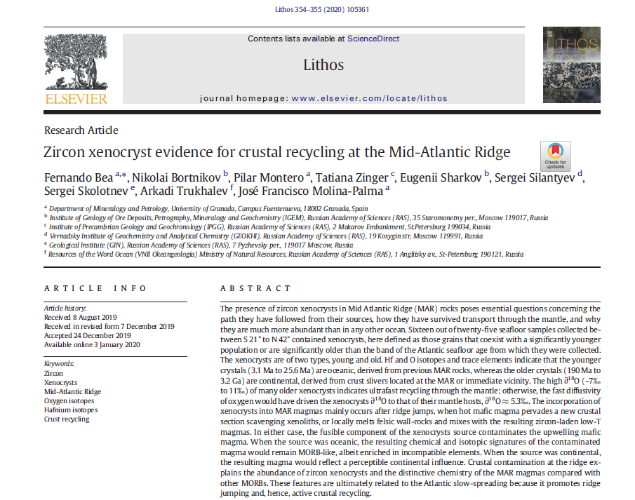
Mantle melting, melt extraction and post-melting processes beneath mid-ocean ridges
What are the implications of this different view of MORB genesis?

Slide 153
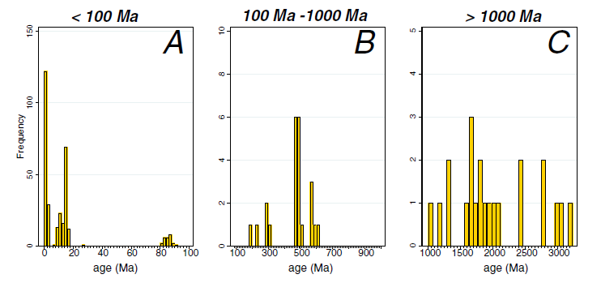
Distribution of SHRIMP U-Pb ages of 350 zircon grains found in twenty-five samples of Mid-Atlantic plutonic and volcanic rocks.

Slide 154
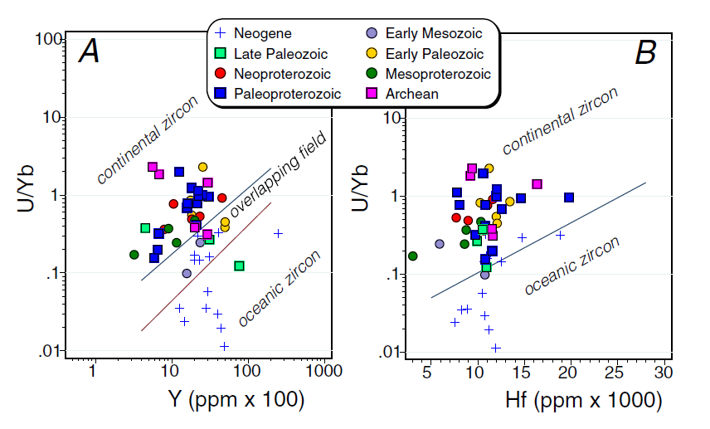
Trace-element discrimination plots of oceanic and continental zircon (Grimes et al., 2007). The younger xenocrysts mostly plot in the field of oceanic zircon whereas the older xenocrysts mostly plot in the field of continental zircon.
The sources of zircon xenocrysts must have been slivers of continental crust preserved in the MAR's vicinity as non-spreading blocks pervaded by upwelling mafic magma.

Slide 155
Mantle melting, melt extraction and post-melting processes beneath mid-ocean ridges
What should you bring home?
What we really know on mantle dynamics is little.
Theoretical and/or physical models often contrast with observations of natural occurrences.
Several geochemical paradoxes (e.g., He and Pb isotopic paradoxes) are still puzzling geochemists.
Also the simplest cases (i.e., the relation between simple upper mantle mineralogy and simple basaltic melt) can give UNEXPECTED results.

Slide 156
Mantle melting, melt extraction and post-melting processes beneath mid-ocean ridges
What should you bring home?
We have previously seen how wrong it could be to define an igneous rock as orogenic or anorogenic (e.g., remember the case of Hawaii).
Now think how many problems can arise when studying igneous rocks generated in very complex tectonic settings like the Mediterranean area.

Slide 157
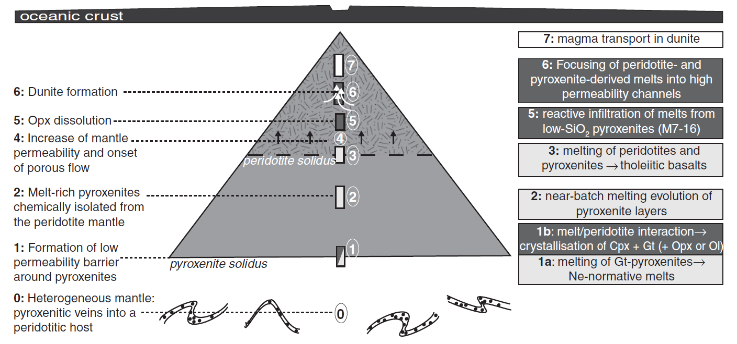
Mantle melting, melt extraction and post-melting processes beneath mid-ocean ridges
Note that in the MORB scheme shown before it is assumed a source made up of peridotite only.
In reality the things are much more complex, in MOR settings too, being upper mantle very heterogeneous.
Lambart et al., 2012 (J. Petrol., 53, 451-476)

Slide 158
Credits:
Baker and Stolper (1994) Geochim. Cosmochim. Acta., 58, 2811-2827
Falloon et al. (2008) J. Petrol., 49, 591-613
Foley et al (2009) Lithos, 112, 274-283
Frost (2008) Elements, 4, 171-176
Herzberg and Zhang (1996) J. Geophys. Res., 101, 8271-8295
Hirschmann (2000) Geochem. Geophys. Geosyst., 2000GC000070
Hirschmann et al. (2008) Geochem. Geophys. Geosyst., doi:10.1029/2007GC001894
Jaques and Green (1980) Contrib. Mineral. Petrol., 73, 287-310
Jing and Karato (2012) Geochim. Cosmochim. Acta, 85, 357-372
Keshav and Gudfinnsonn (2013) J. Geophys. Res., 118, 1–13, doi:10.1002/jgrb.50249
Lambart et al. (2012) J. Petrol., 53, 451-476
Lindsley (1983) Am. Mineral., 68, 477-493
Lustrino et al. (1999) Per. Mineral., 68, 13-42
Niu (1997) J. Petrol., 38, 1047-1074
Niu (1999) J. Petrol., 40, 1195-1203
Niu (2004) J. Petrol., 45, 2423-2458
Ohtani (2009) Chem. Geol., 265, 279-288
Ohtani et al. (1995) Chem. Geol., 120, 207-221
Raterron et al. (1997) Phys. Earth Chem. Int., 89, 77-88.
Stixrude and Lithgow-Bertelloni (2011) Geophys. J. Int., 184, 1180-1213.
Walter (1999) J. Petrol., 40, 1187-1193.
Wyllie and Riabchikov (2000) J. Petrol., 41, 1195-1206.
Anyone can use this material for scientific and non-scientific purposes.
Please quote and acknowledge the source of data

